Slide 1
Solutions to Climate Change
Columbia Splash
Fall 2021
Sally Green

Slide 2
Hi!
Hi, I’m Sally
Why I’m teaching this class
How this class will work:
I will talk through stuff
Sometimes I will ask you questions or give you things to think about, and you can
Write your answer down on a sheet of paper
Write your answer in the chat
Raise your hand using Zoom’s “raise hand” feature and I’ll call on you
At the end, we will discuss our thoughts and takeaways

Slide 3
What we’re going to talk about today
What is Climate Change and why is it a problem
The underlying problems
Types of solutions & Project Drawdown
Wind power
Solar power (photovoltaic)
Advances in energy storage
Agriculture/food/diet
Other solutions, why aren’t we doing more, hope
Reflection

Slide 4
What is Climate Change, and why is it a problem? (Why do we need “solutions”?)

Slide 5
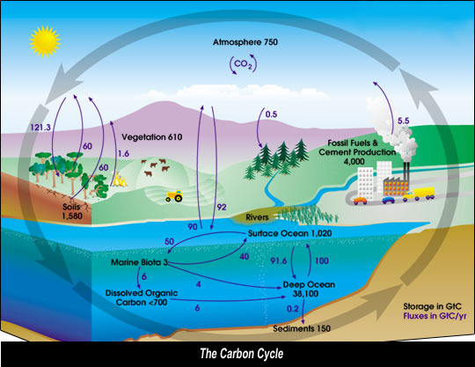
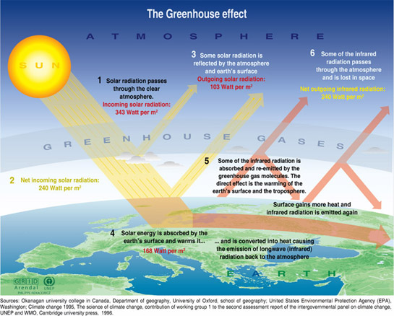
What is Climate Change?
Climate Change is not a scientific controversy
image from NASA
Notes:
Image on the left: https://ozcoasts.org.au/indicators/coastal-issues/greenhouse_effect/
Image on the right: https://airs.jpl.nasa.gov/resources/157/carbon-cycle/

Slide 6
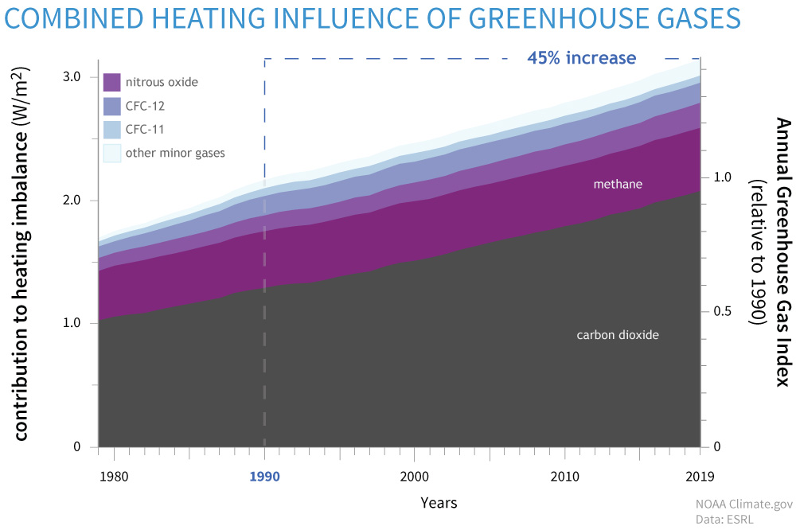
(Side note: Carbon dioxide is not the only greenhouse gas, but it is the main one.)
image from climate.gov

Slide 7
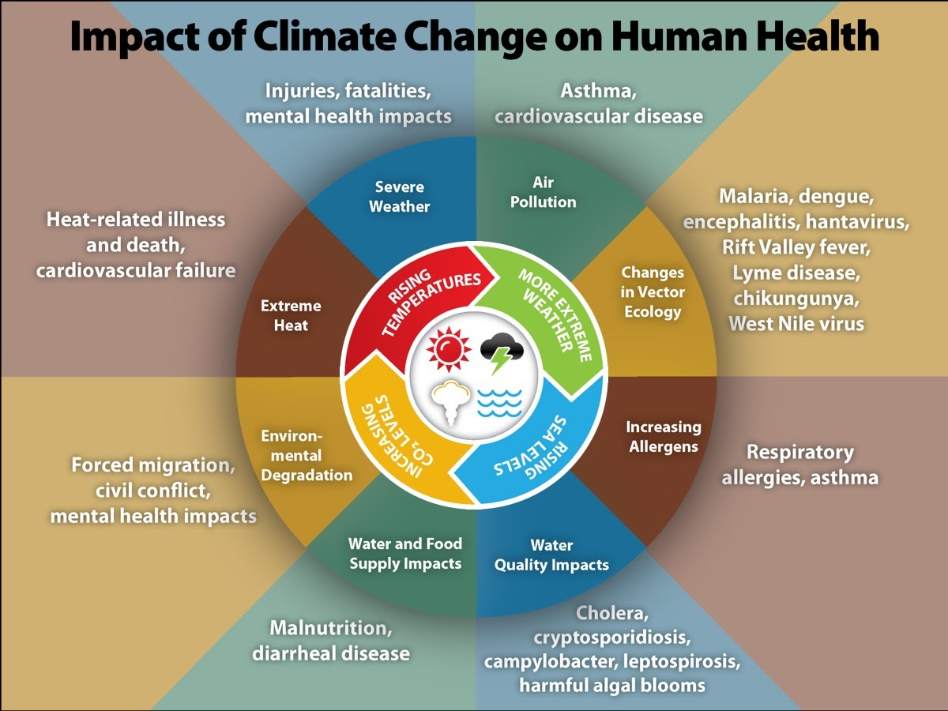
So what? Why is Climate Change a problem?
This is just human health; climate change also impacts the health of many other animals and plants on earth!
These impacts are happening now.
image from cdc.gov
Notes:
Source of image: https://www.cdc.gov/climateandhealth/effects/default.htm

Slide 8
Why is Climate Change a problem NOW?

Slide 9
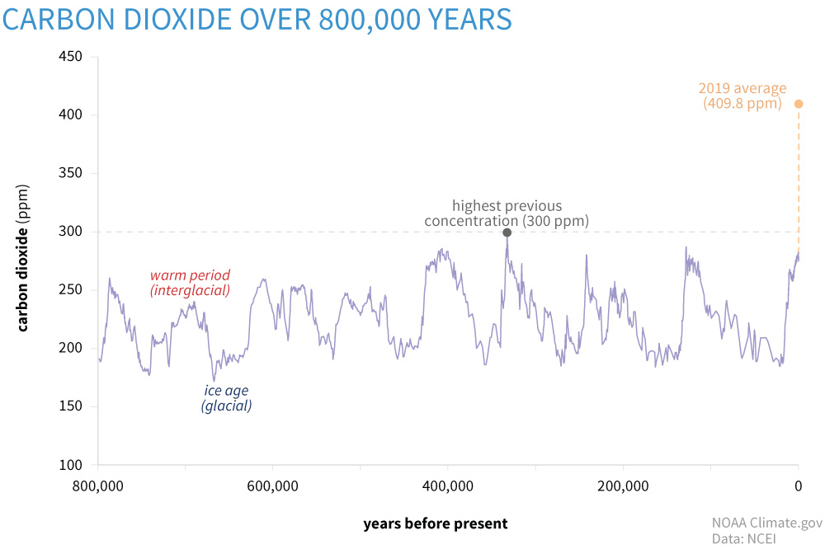
image from climate.gov

Slide 10
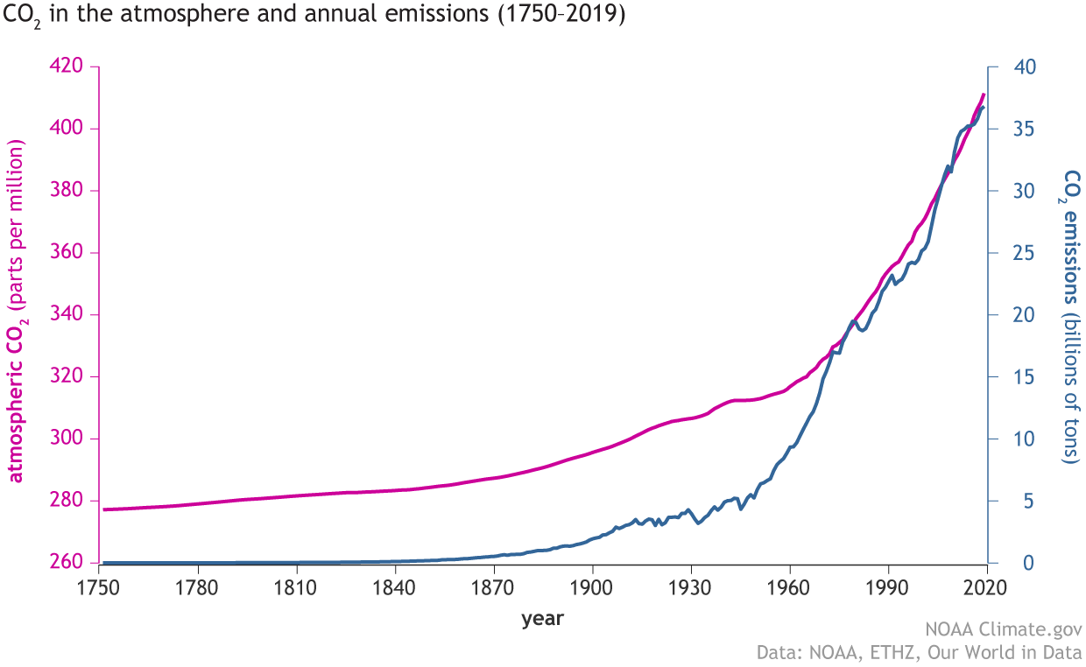
What changed?
Industrial Revolution
Burning fossil fuels
image from climate.gov

Slide 11
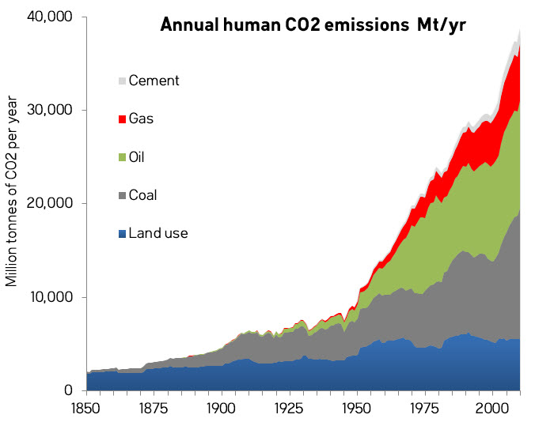
What factors caused this change?
image from skepticalscience.com
Notes:
https://winrock.org/westool/greenhouse-gas-emissions-from-land-use-and-land-use-change/
https://www.skepticalscience.com/EmmissionsAcceleration.html

Slide 12
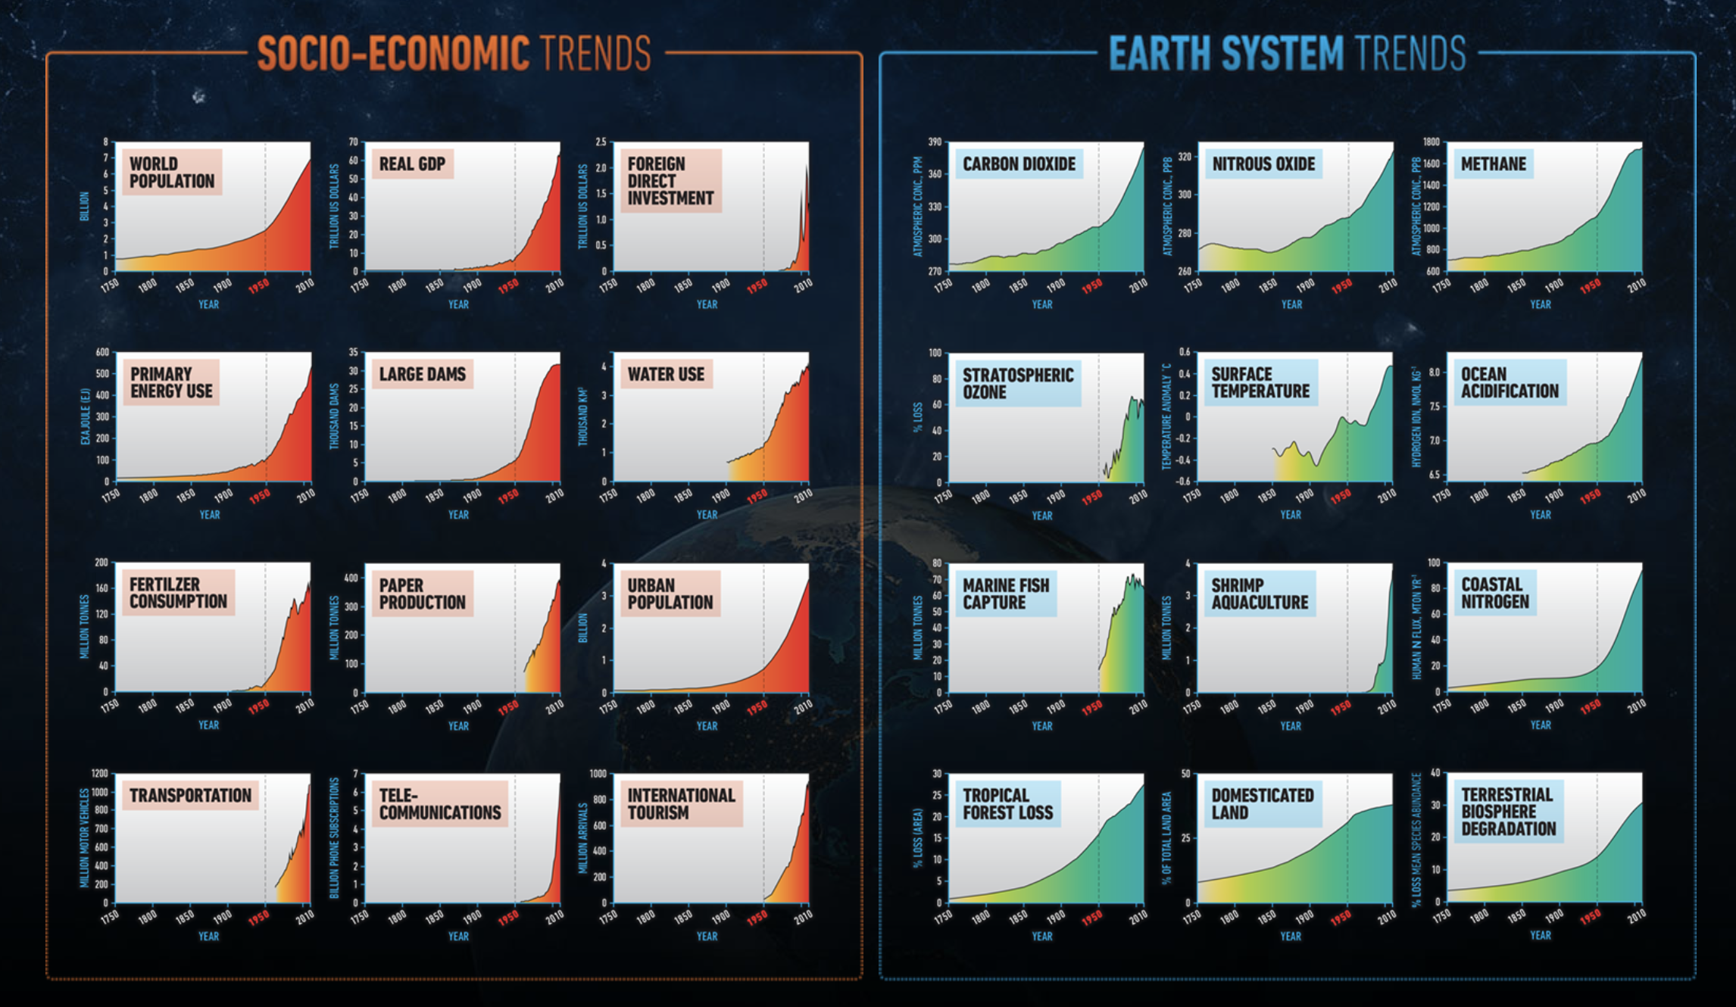
The Great Acceleration
image from anthropocene.info
1750
1950
2010
1750
1950
2010
Notes:
http://www.anthropocene.info/great-acceleration.php

Slide 13
What is Climate Change?
Why is a problem?
Why is it a problem now?
What changed?
Increased demand for energy/electricity
Increased demand for food (agriculture)

Slide 14
Solution: Sustainability
“the ability to be maintained at a certain rate or level”
-Oxford Languages
“meeting the needs of the present without compromising the ability of future generations to meet their needs”
-Investopedia

Slide 15
There is a need for sustainable energy, food, water, places to live, lives...
We can meet the increased need for energy/electricity with renewable energy
We can meet the increased need for food by decreasing demand for meat and dairy, and by making agriculture more sustainable

Slide 16
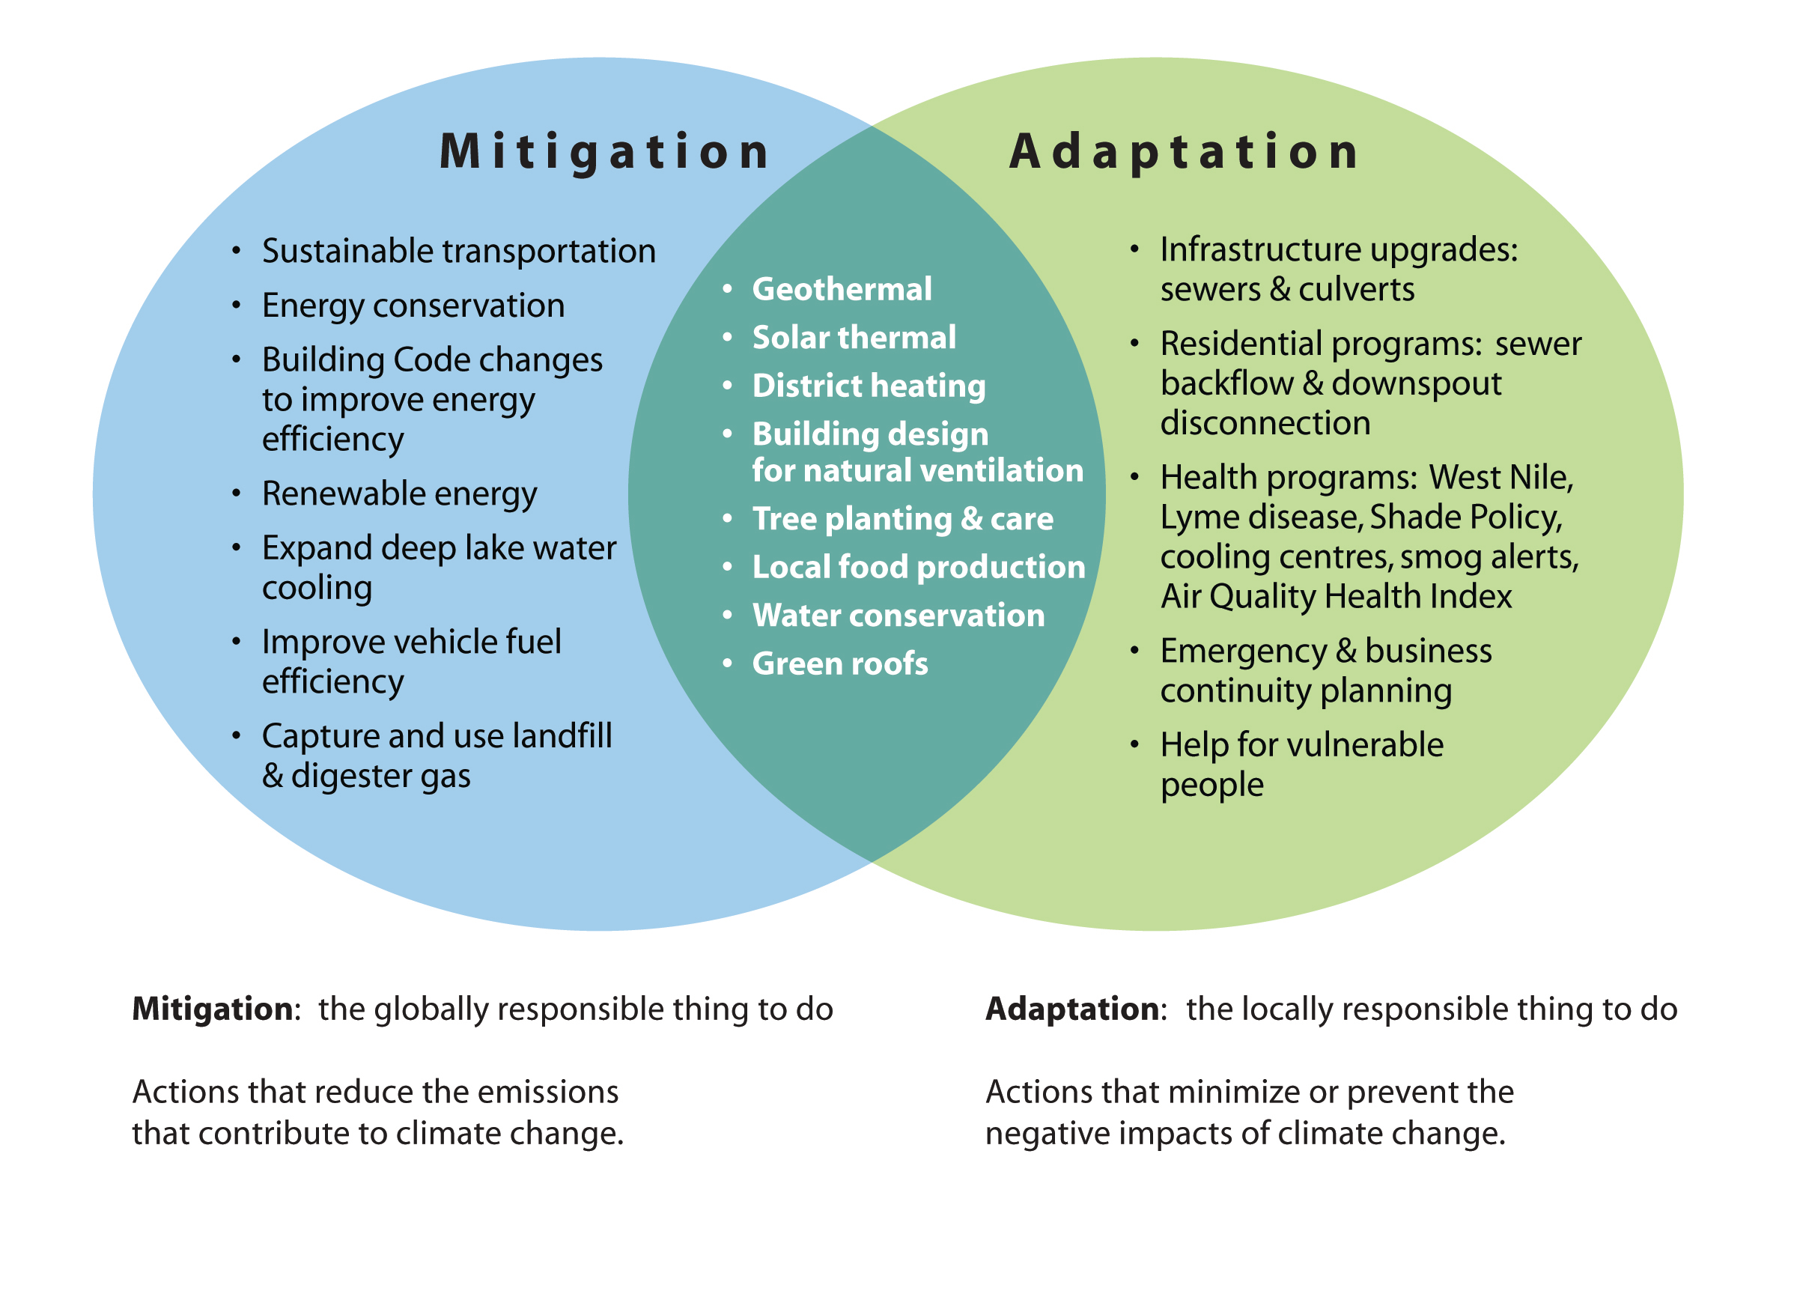
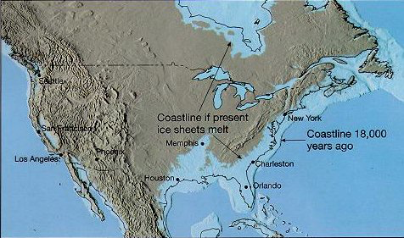
Types of solutions
Short term vs. long term
Reversal, mitigation, and adaptation
Notes:
Image on the left: https://www.quora.com/If-we-melt-Antarctica-would-any-land-masses-around-Earth-go-under-water
Image on the right: https://www.researchgate.net/figure/Green-spaces-as-means-to-both-mitigate-and-adapt-to-climate-change-4_fig1_228720496

Slide 17
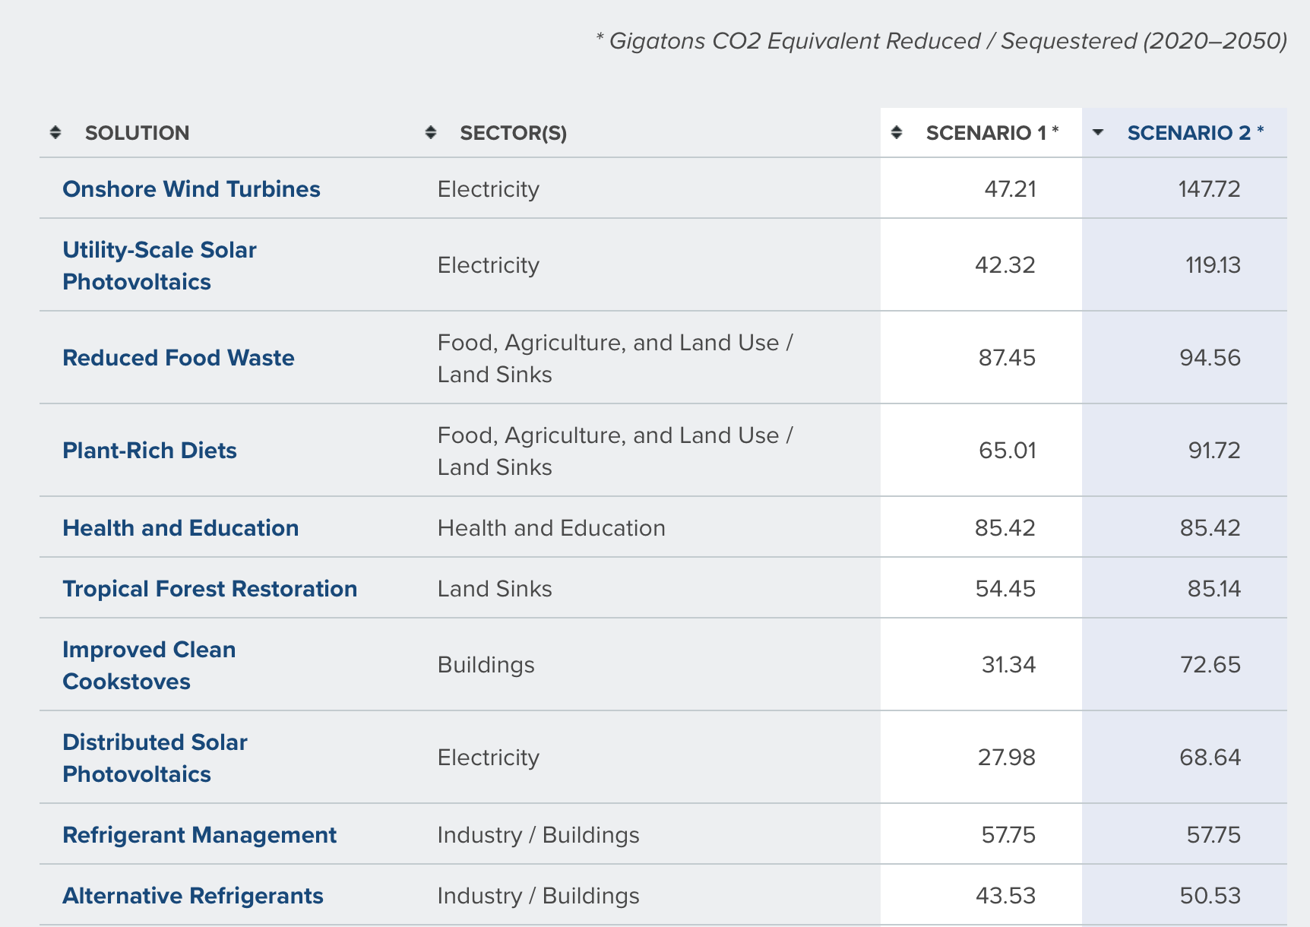
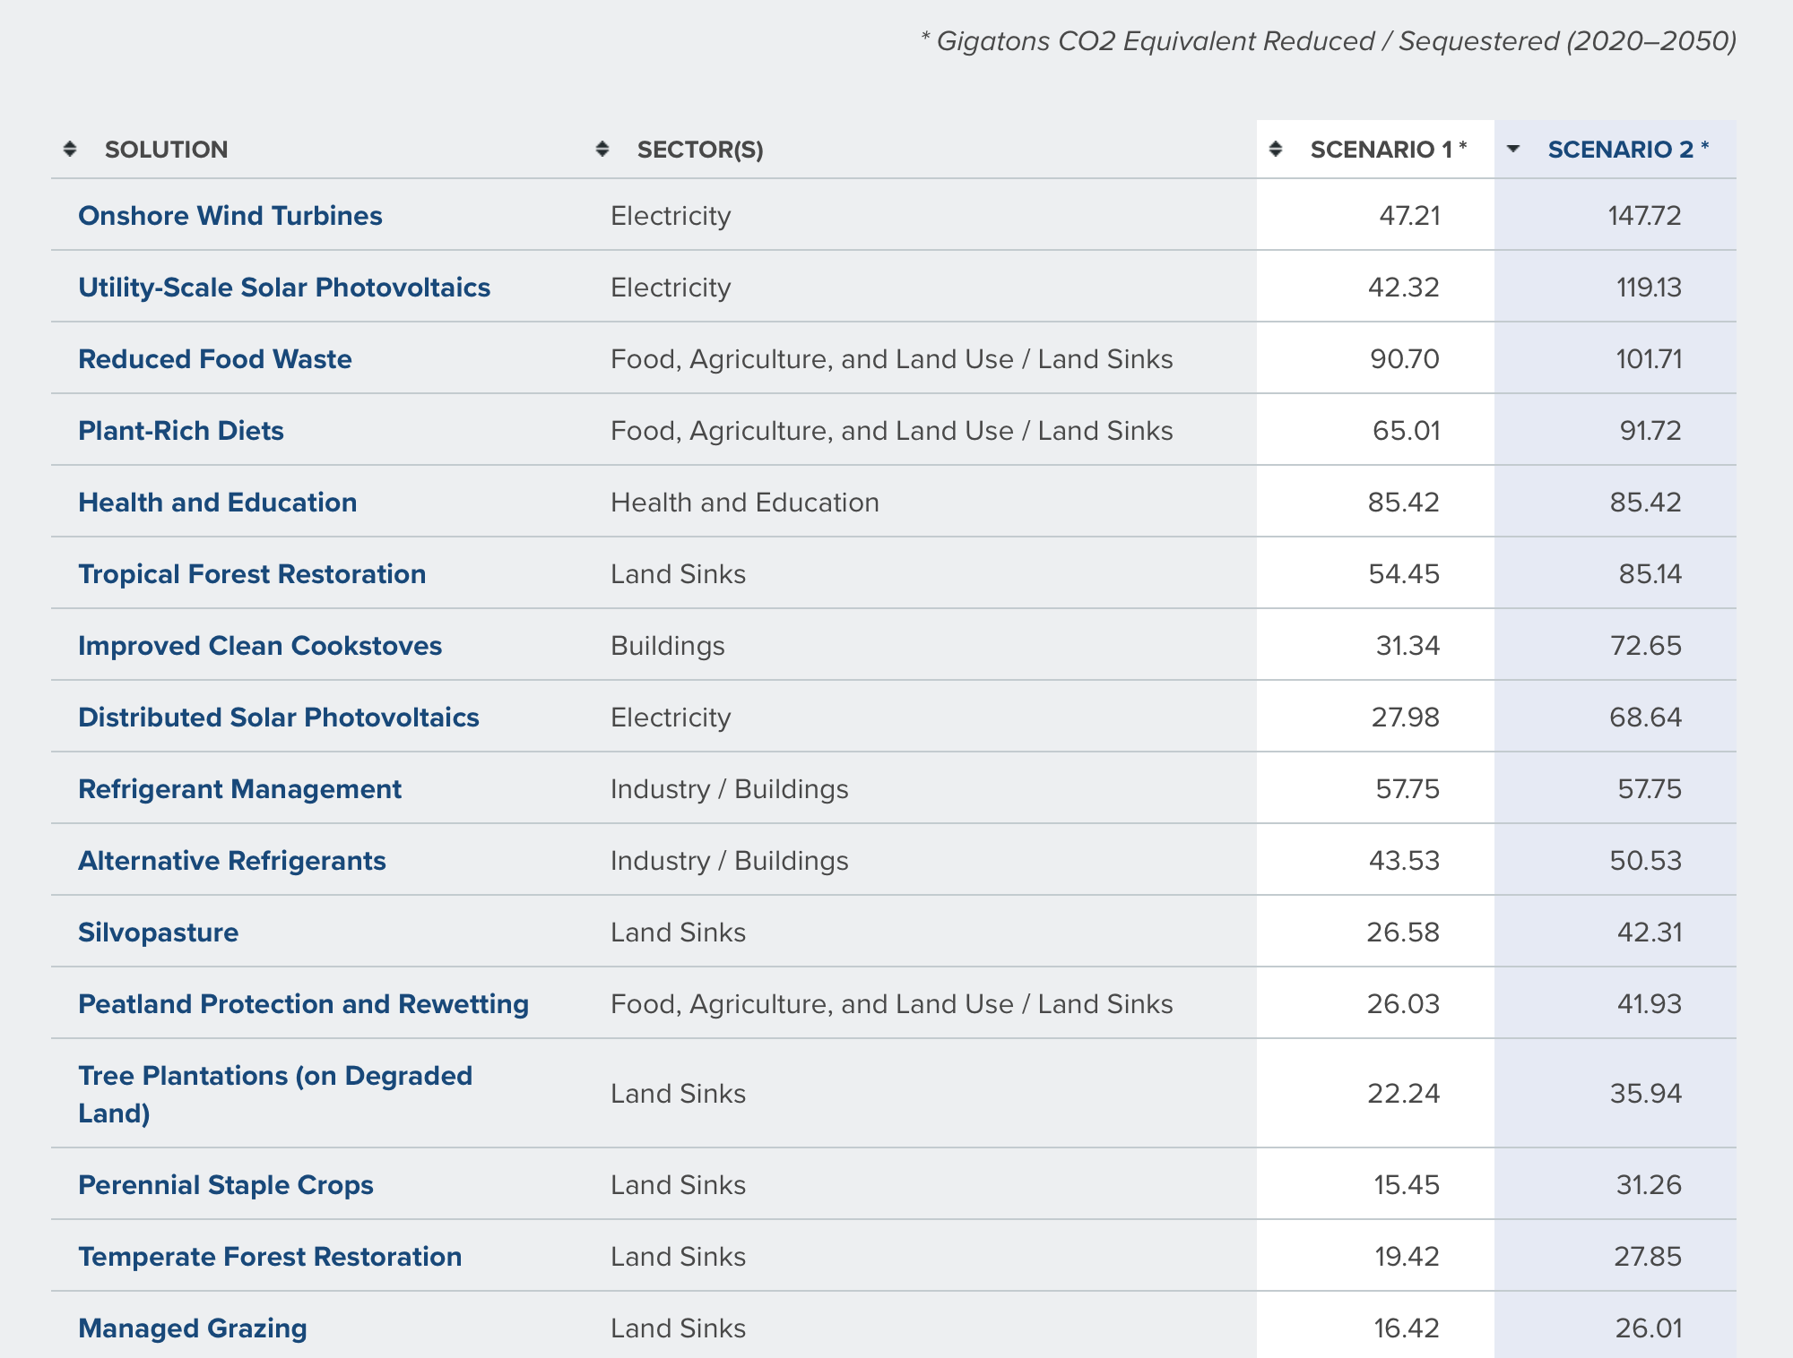
Project Drawdown’s Solutions
Drawdown book was published in 2017
drawdown.org
Notes:
https://www.drawdown.org/solutions/table-of-solutions

Slide 18
Forms of Energy
Energy cannot be created or destroyed, only converted
Kinetic energy (the energy of movement) = ½*m*v^2
Radiant/electromagnetic energy (light)
Electric potential energy (electricity)
Chemical energy (stored in chemical bonds; released by breaking the bonds)
Thermal energy (heat)
Gravitational potential energy = mgh
Elastic potential energy (e.g. springs)
Nuclear energy
Sound energy
Etc.

Slide 19
Wind Turbines

Slide 20
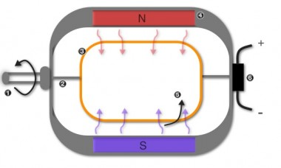
Wind Power
Movement of the wind → electricity
Electric generator:
A wire conductor moving through a magnetic field creates an electric current. (Faraday’s Law of Induction)
Kinetic energy (the energy of movement) from wind blowing
½ m v^2
Electric potential energy
kWh (kilo Watt hours)
Notes:
Source of wind turbine image: https://www.next.cc/journey/design/wind-power
Source of generator image: https://www.turbinegenerator.org/generator-works/

Slide 21
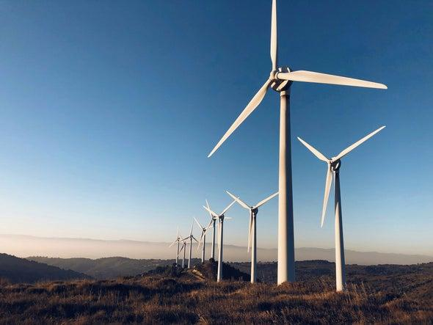
Wind turbine extracts power and decreases the velocity of the wind
*assuming turbine is operating at max efficiency, the Betz Limit
V=8 m/s
V=5.3* m/s
½*m*v^2
½*m*v^2
electricity
Notes:
Source for image: https://www.scientificamerican.com/article/giant-turbines-propel-boom-in-wind-energy/

Slide 22
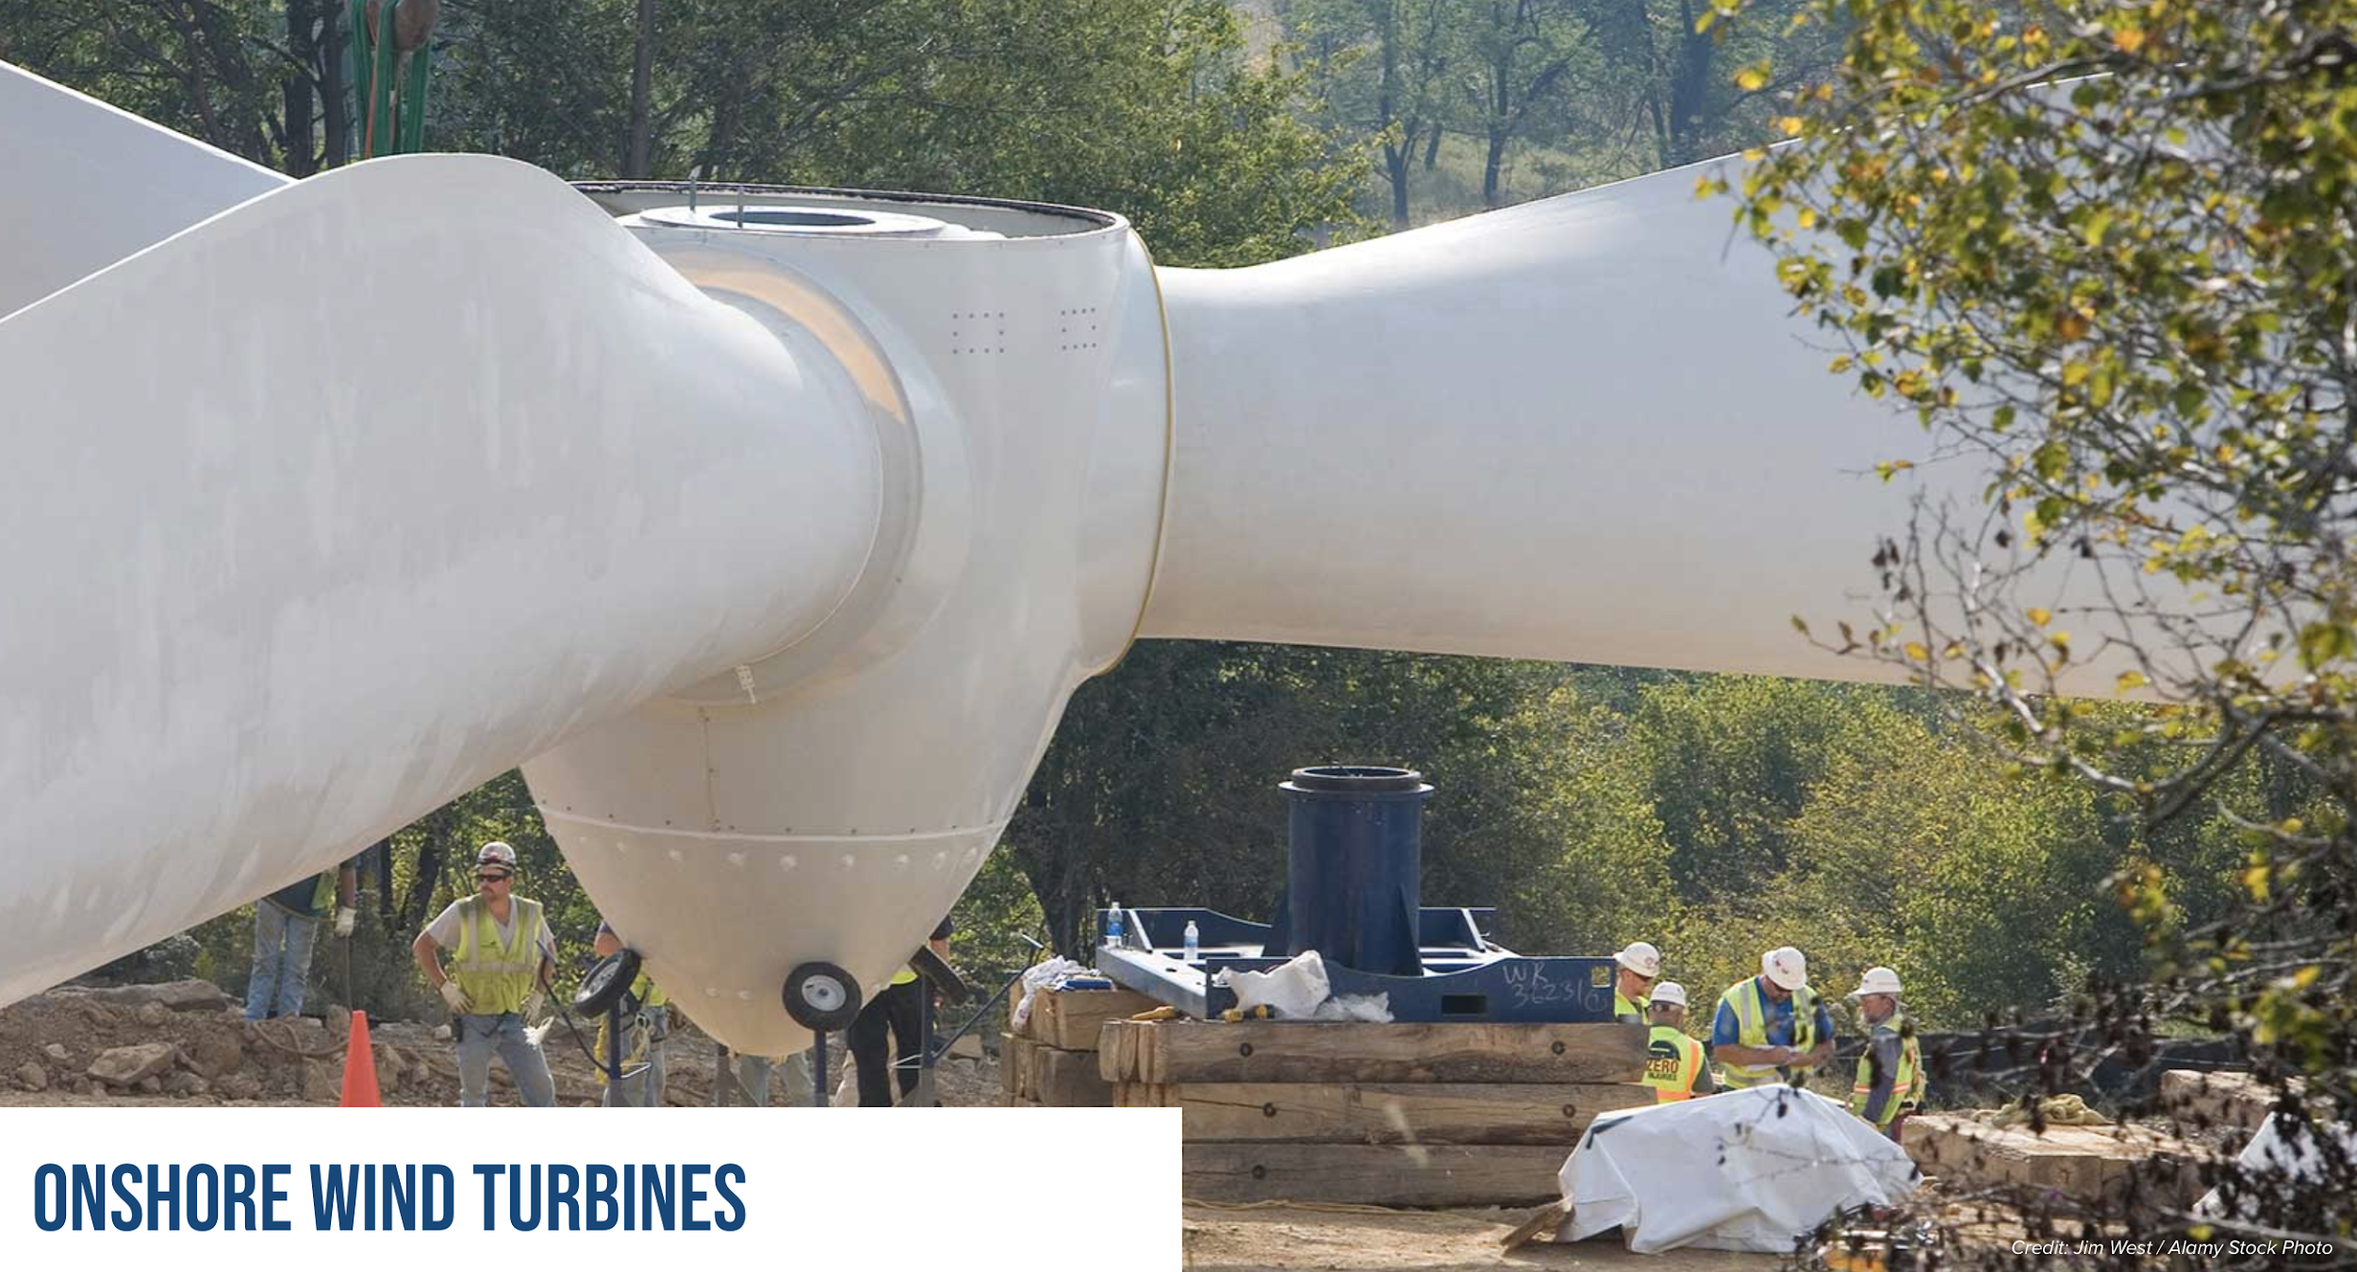
Wind turbines can be huge! Wind blows faster higher up.
image from drawdown.org

Slide 23
Higher wind speed = more energy. Where is it consistently fast?
image from Professor Vijay Modi’s class “Energy Sources and Conversion”

Slide 24
Solar Power

Slide 25
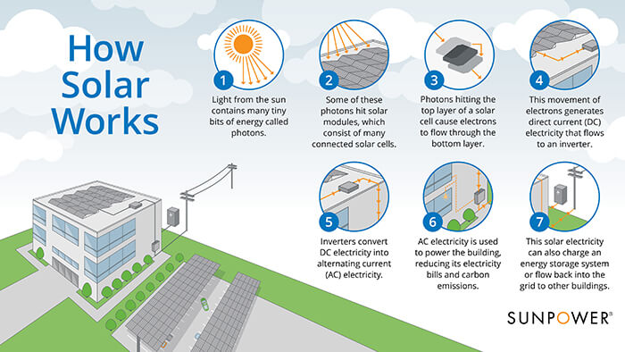
Solar radiation is converted to electricity
What would need to happen for solar power to be more widespread?
Notes:
Source of image: https://sunpower.maxeon.com/int/blog/solar-basics-how-do-solar-panels-work

Slide 26
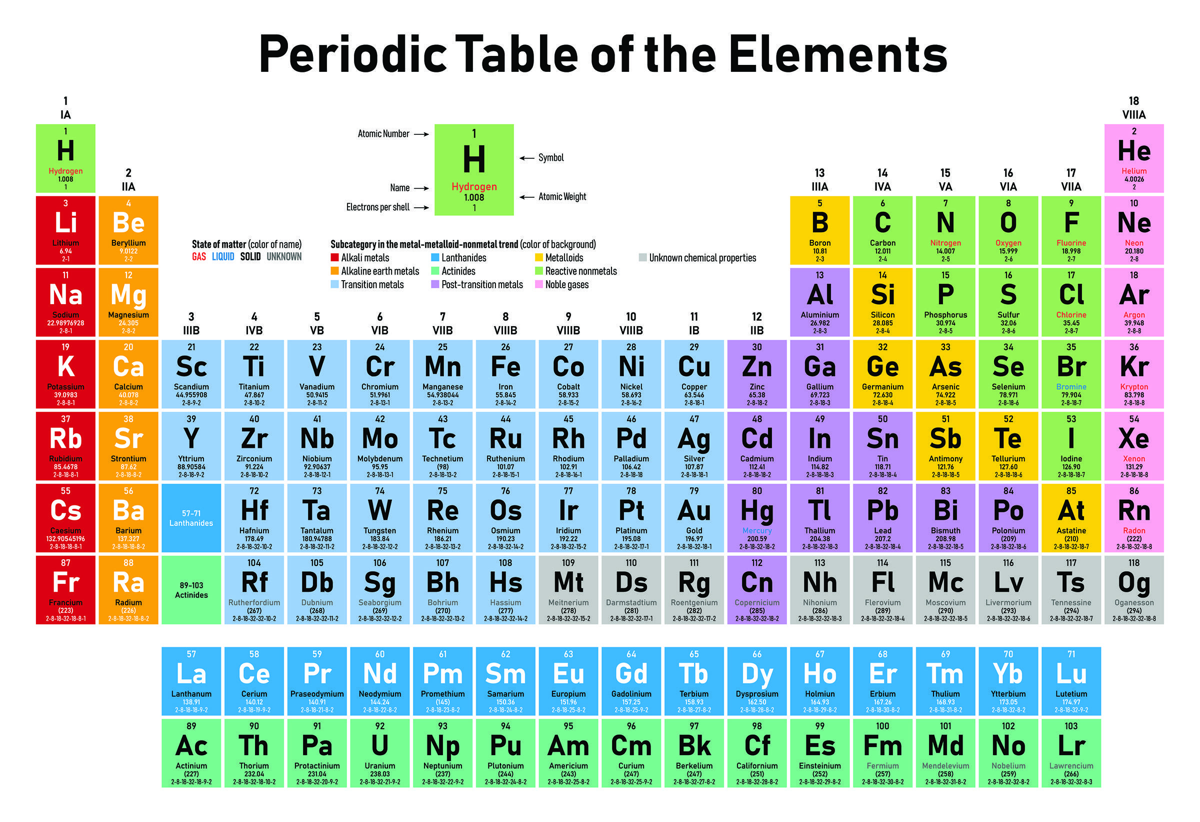
Semiconductors
Notes:
Source of periodic table image: https://www.wuwm.com/post/periodic-table-elements-turns-150#stream/0

Slide 27
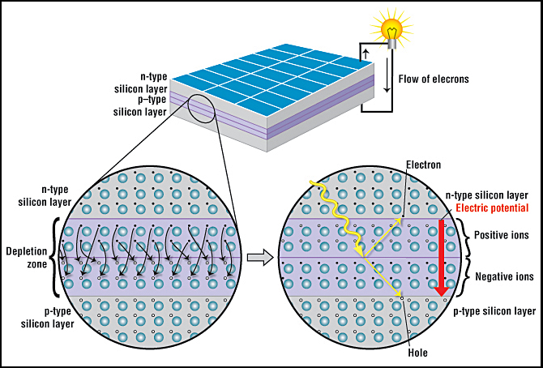
Inside a solar panel
Notes:
Image from https://www.acs.org/content/acs/en/education/resources/highschool/chemmatters/past-issues/archive-2013-2014/how-a-solar-cell-works.html

Slide 28
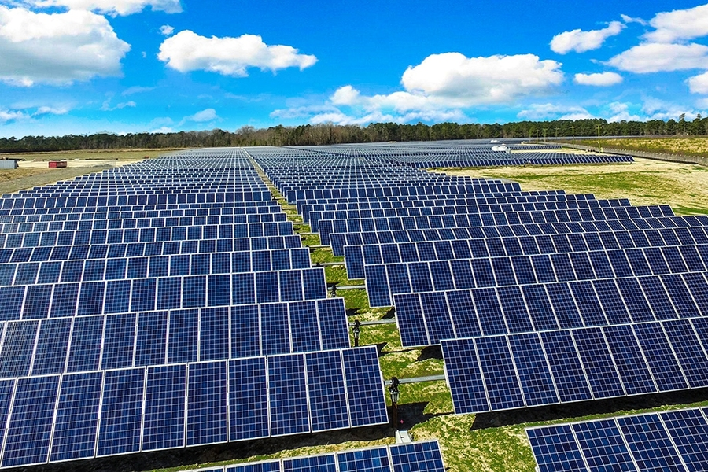
An array of solar panels in a field
Notes:
Source for image: https://news.mit.edu/2020/researchers-find-solar-photovoltaics-benefits-outweigh-costs-0623

Slide 29
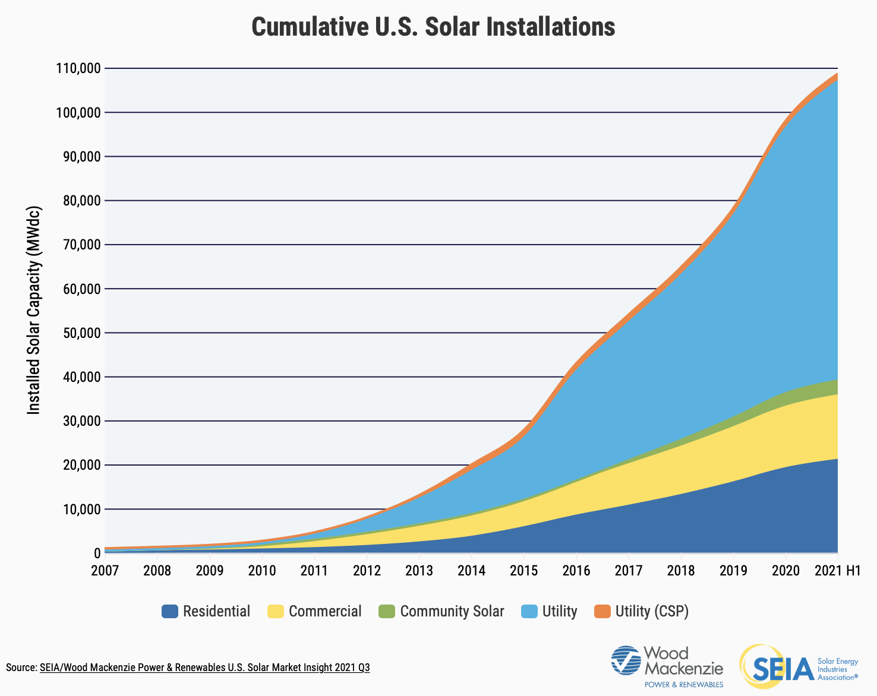
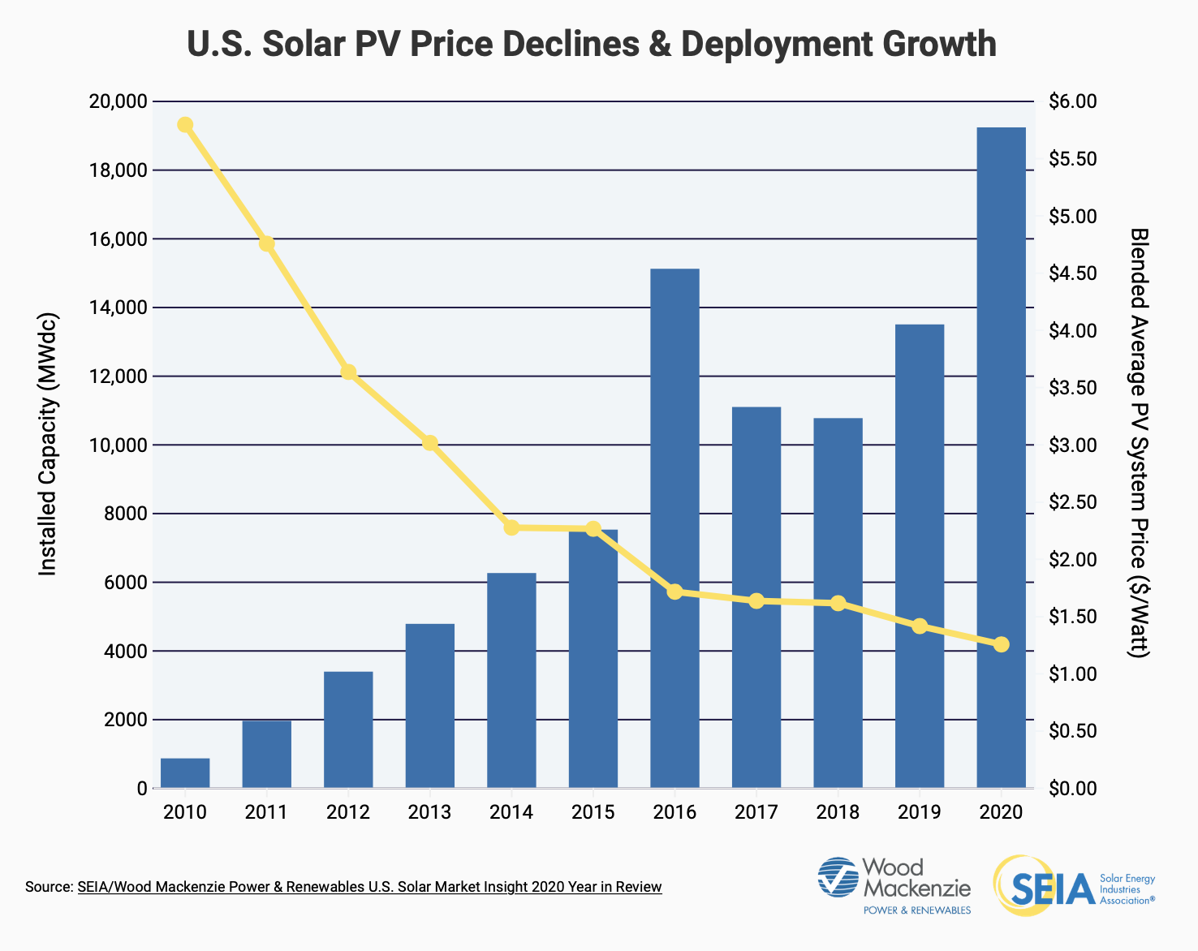
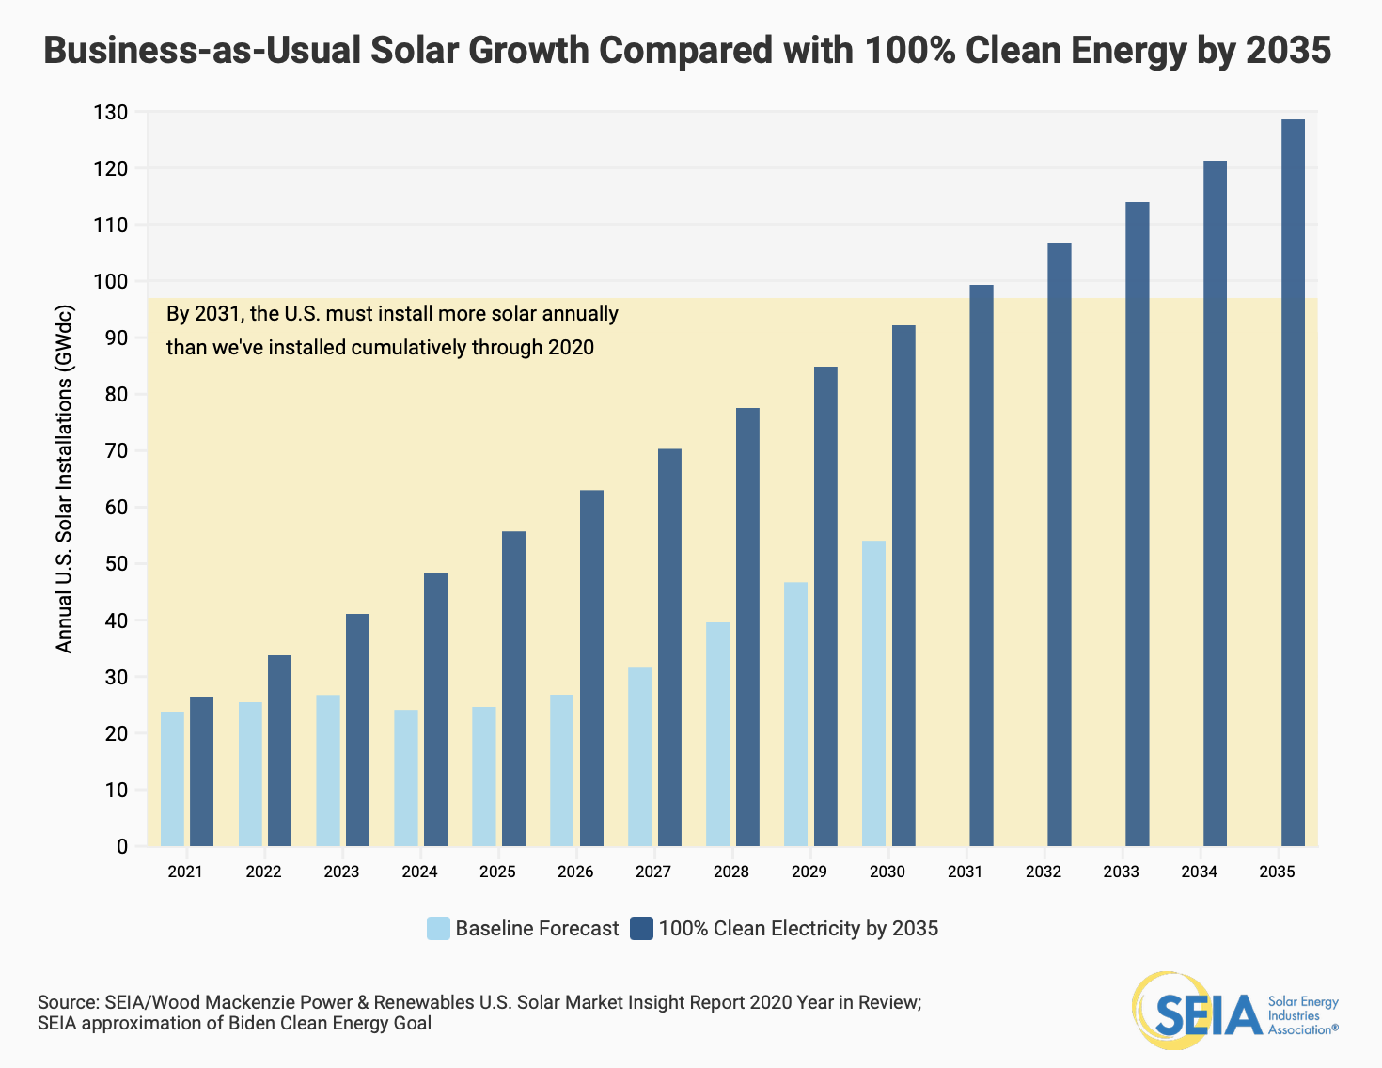
Obstacles that have been dealt with:
Cost
Falling prices
Tax credits
Community solar!!!
Space, installations
Fields, schools, churches, government buildings, along highways
Efficiency
Nowadays, ~30%
It’s a dialectic: We are making great progress, AND we need to do better.
Notes:
https://www.seia.org/solar-industry-research-data

Slide 30
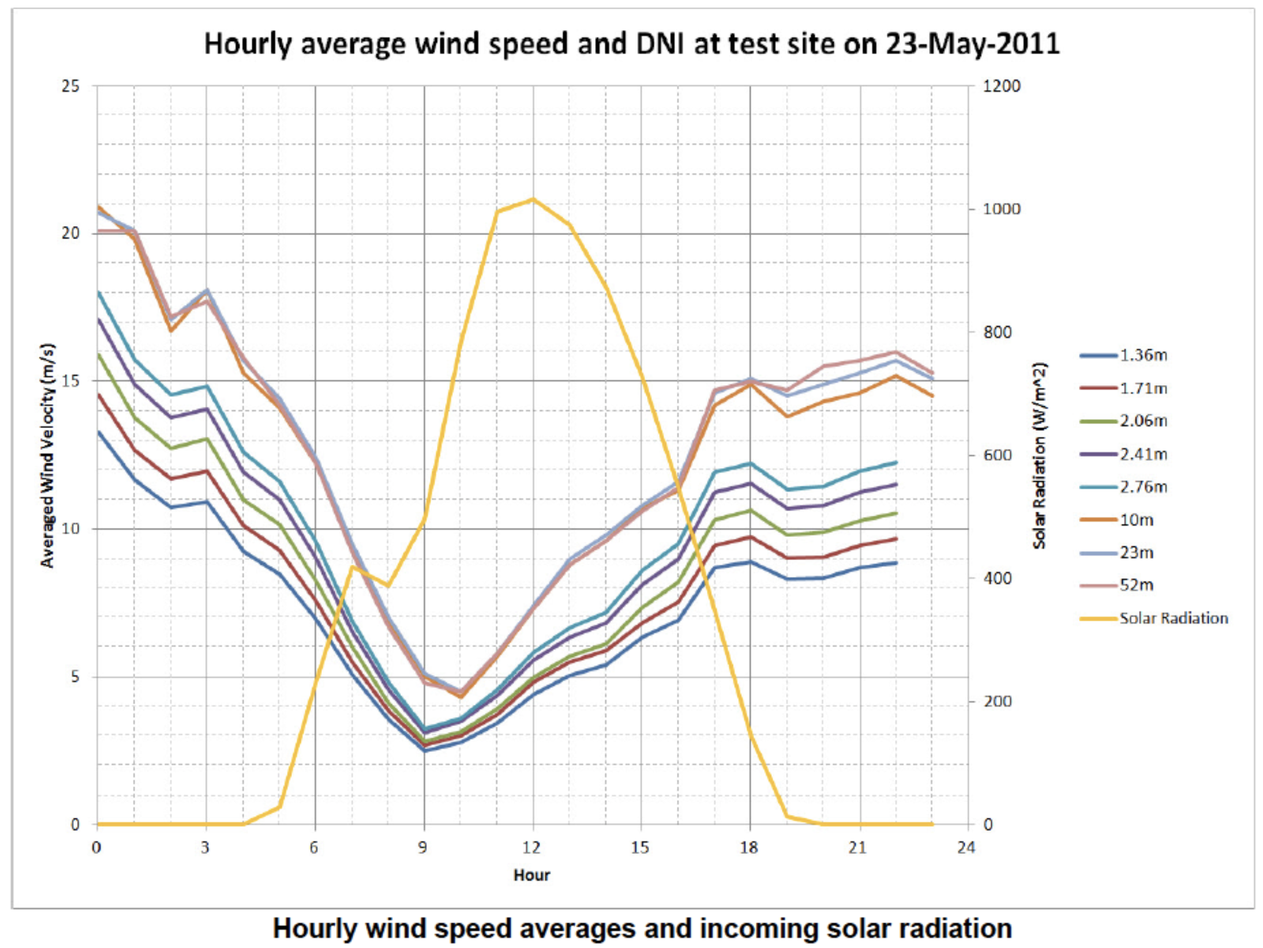
Solar and Wind Energy are both variable, but they can balance each other out.
image from Professor Vijay Modi’s class “Energy Sources and Conversion”
(note that these graphs are not on the same y-axis scale)

Slide 31
Efficiencies?
Efficiencies can increase over time as technology improves, but are ultimately limited by fundamental properties of nature/physics
Solar power: Depends on material, wiring, reflection, etc.
In practice: 20% [Source 1]
Wind power: The Betz Limit: Cp (power coefficient) = 16/27 = 59%
In practice: 42% [Source 2]
Gas-fired steam turbine power plants: Carnot Limit: ~51%
In practice: 40% [Source 3]
Car engines: Carnot Limit: 37%.
In practice: 20% [Source 3]
These all use moving air to drive a turbine that turns a generator and creates electricity. Steam, or thermal, power plants burn something to create steam that turns the turbine. Wind turbines use wind we already have.
Notes:
Source 1: https://news.energysage.com/what-are-the-most-efficient-solar-panels-on-the-market/
Source 2: http://homework.uoregon.edu/pub/class/350/out350/windbasics.html
Source 3: https://news.mit.edu/2010/explained-carnot-0519

Slide 32
Solar and wind energy, (combined with some energy storage (e.g. batteries) and an electrical grid) can meet the need for increased energy/electricity demand.

Slide 33
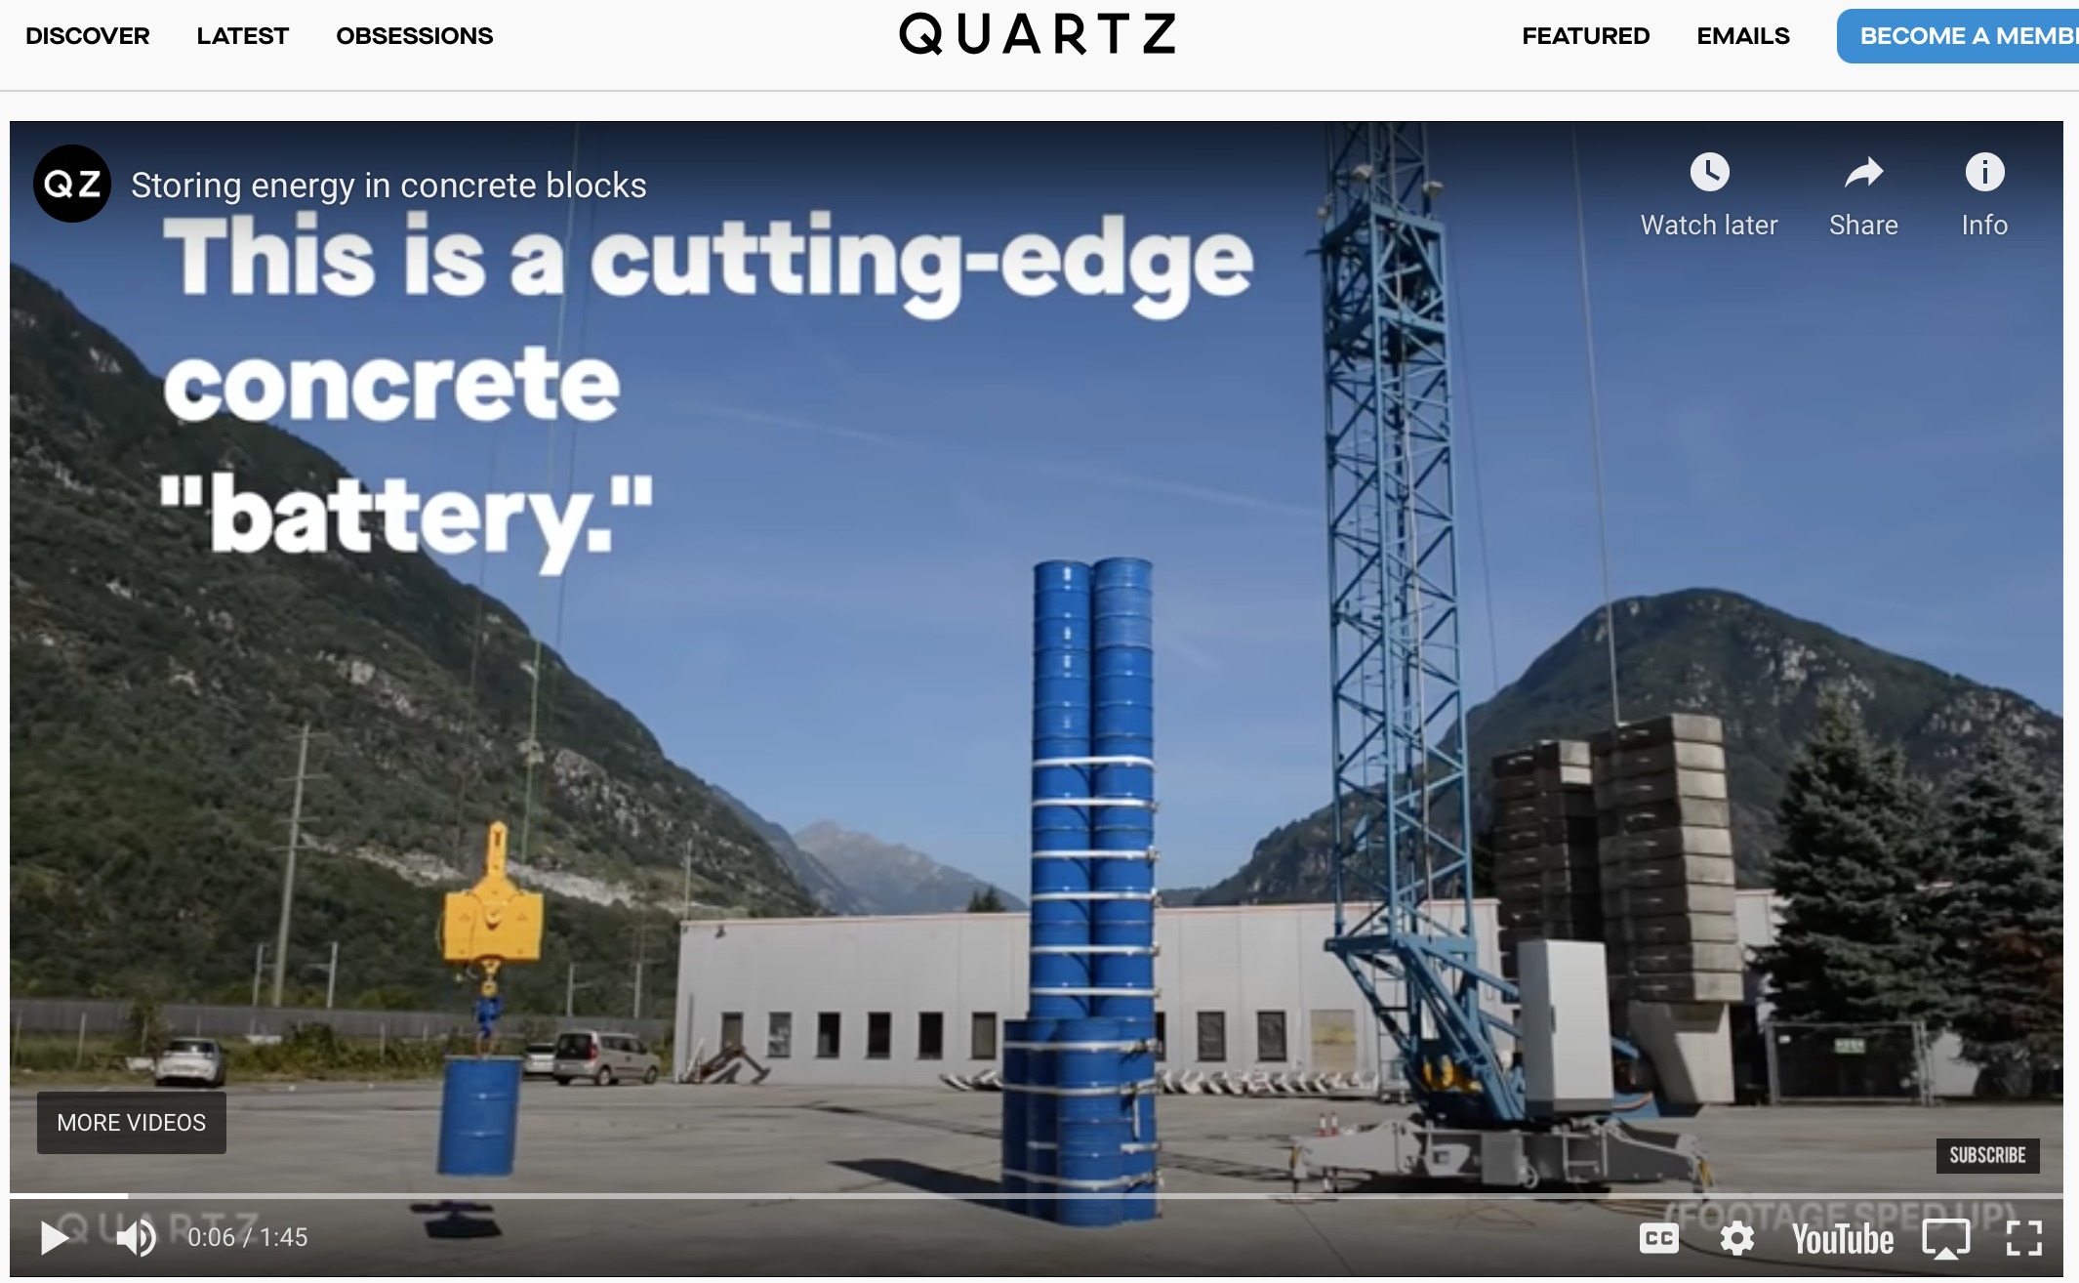
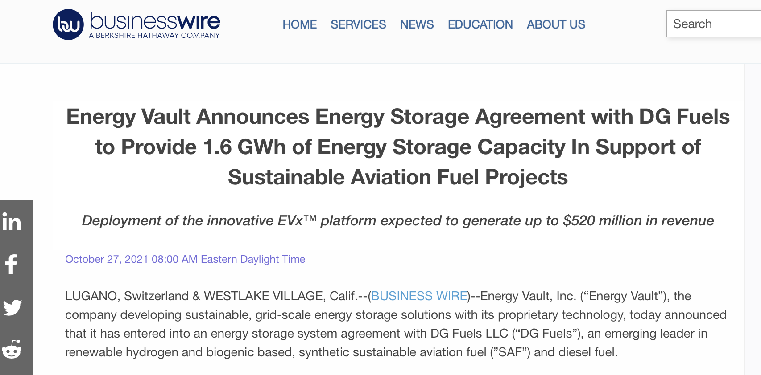
Another reason for hope: advances in energy storage
Article from Oct. 2021 – they’re making it happen!!
Using cranes and blocks to store energy when there’s excess; lowering blocks to turn a generator when there is a lack
Article from 2018 demonstrating storing energy as gravitational potential energy

Slide 34
Another reason for hope: advances in energy storage
Use excess renewable energy to transform abundant low-energy molecules like H2O and CO2 to hydrogen gas, formic acid, methane, and methanol.
These are sources for industrial feedstocks and fuels.
Electrolysis:
→ Splitting water (H2O) into H2 and O2 using renewable energy
Biological processes:
→ Microorganisms can transform hydrogen gas and carbon into methane, which is natural gas!
Notes:
https://www.nrel.gov/about/electrons-to-molecules.html

Slide 35
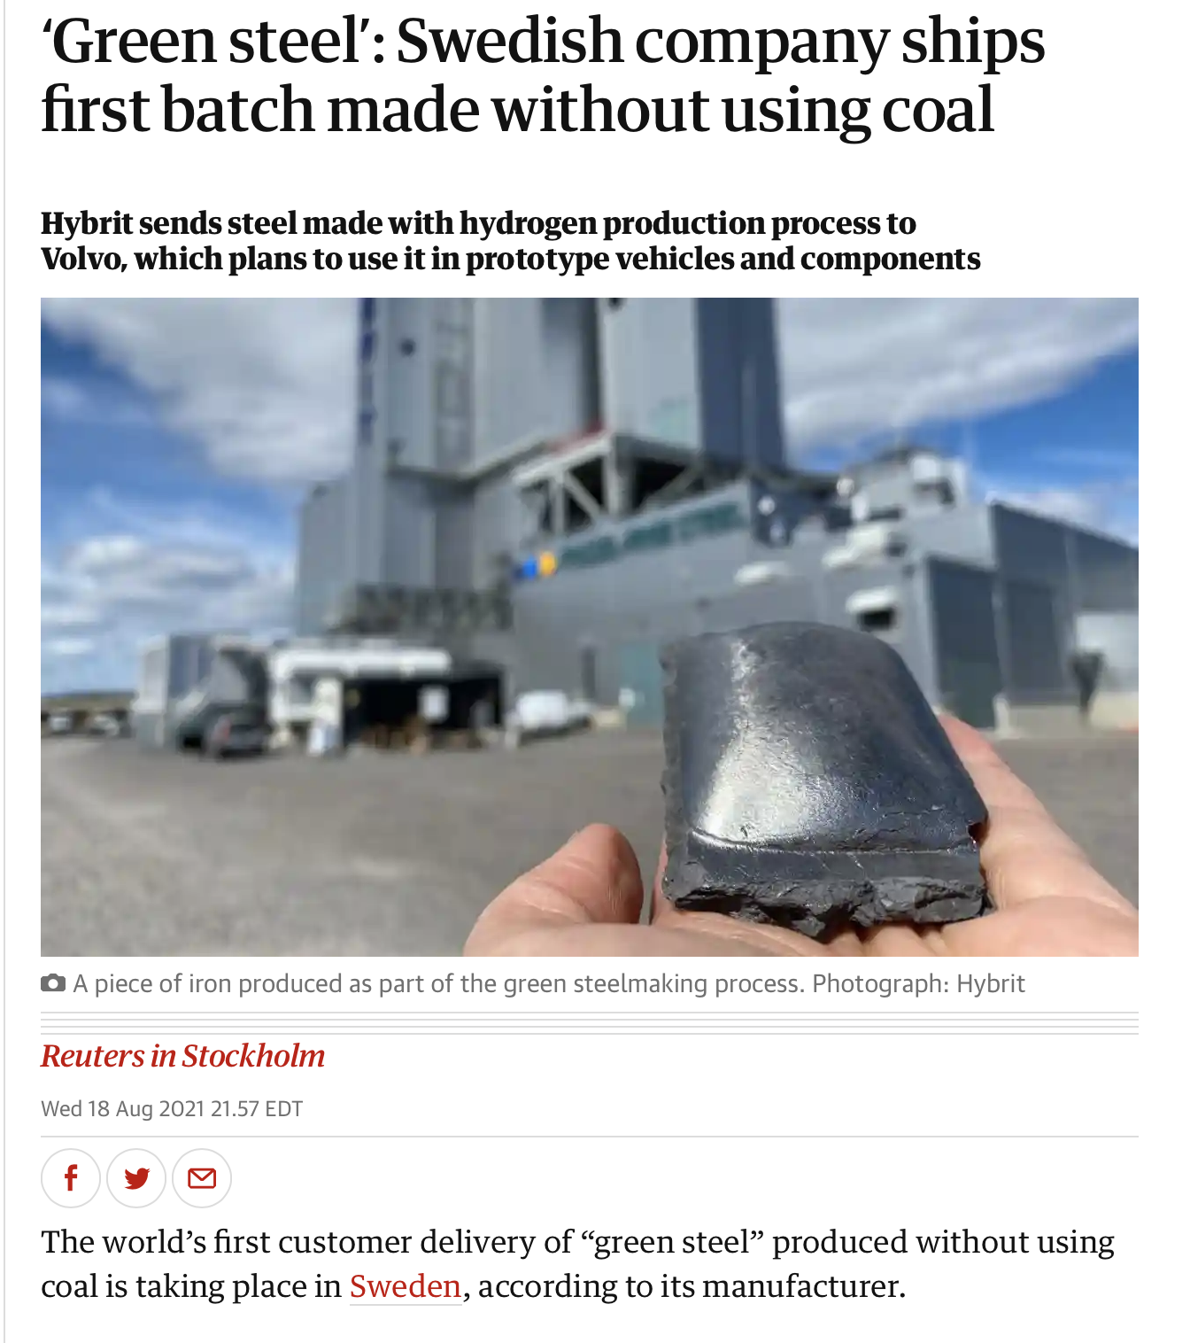
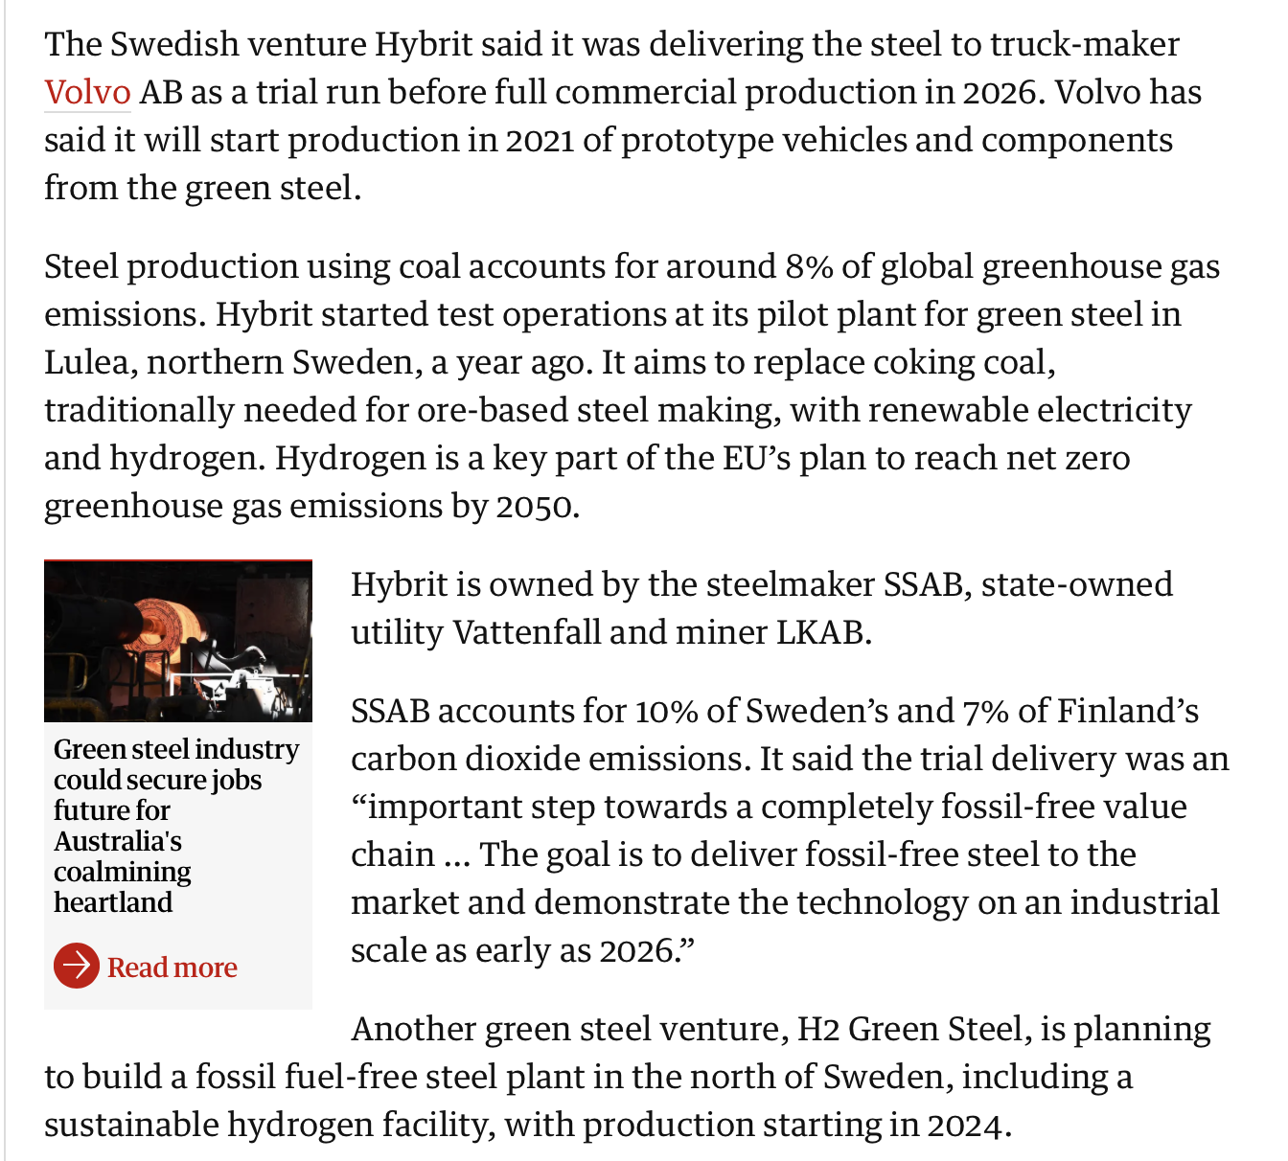
Relatedly, one thing you can do with that hydrogen: make Green Steel!
Use that H2 to make steel without coal!! It’s been done!! ☺
Notes:
https://www.theguardian.com/science/2021/aug/19/green-steel-swedish-company-ships-first-batch-made-without-using-coal

Slide 36
Agriculture, food, and diet

Slide 37
Agriculture/food -- reducing meat and dairy consumption reduces GHG footprint
Globally, food production — and the production of meat in particular — accounts for ¼ of the world’s GHG emissions and takes up ½ of the planet’s habitable surface. [source: carbonbrief] So eating less meat can lead to big savings on emissions.
any reduction in meat and dairy consumption has an impact
Notes:
[Source 1] https://interactive.carbonbrief.org/what-is-the-climate-impact-of-eating-meat-and-dairy/
Globally, food production — and the production of meat in particular — produces around the same amount of greenhouse gases (14.5%) [source 2] as power plants. So eating less meat can lead to big savings on emissions.
[2] 14.5 percent of human-induced GHG emissions (globally) are caused by the livestock sector http://www.fao.org/3/i3437e/i3437e.pdf

Slide 38
Why does meat have such a large footprint?
Nutrient needs
Takes a lot of lbs of feed to make 1 lb of meat
Water use
Nearly ½ water used in US goes to raising animals for food
Land use
30 % of Earth’s land is dedicated to raising animals for food
Meat, aquaculture, eggs and dairy use about 83 percent of the world's farmland
Acidification/eutrophication
More frequent harmful algal blooms (HABs) are caused by excessive levels of phosphorus from fertilizer and manure
Notes:
Not to mention the large amounts of pesticides/antibiotics used running off into water and promoting pesticide or antibiotic resistance.
https://insideclimatenews.org/news/31052018/environmental-impacts-food-production-climate-change-meat-vegetarian-vegan-diets-global-warming-study
https://insideclimatenews.org/news/15052018/algae-blooms-climate-change-methane-emissions-data-agriculture-nutrient-runoff-fertilizer-sewage-pollution-lake-erie
[This slide was originally made by Columbia EcoReps]

Slide 39
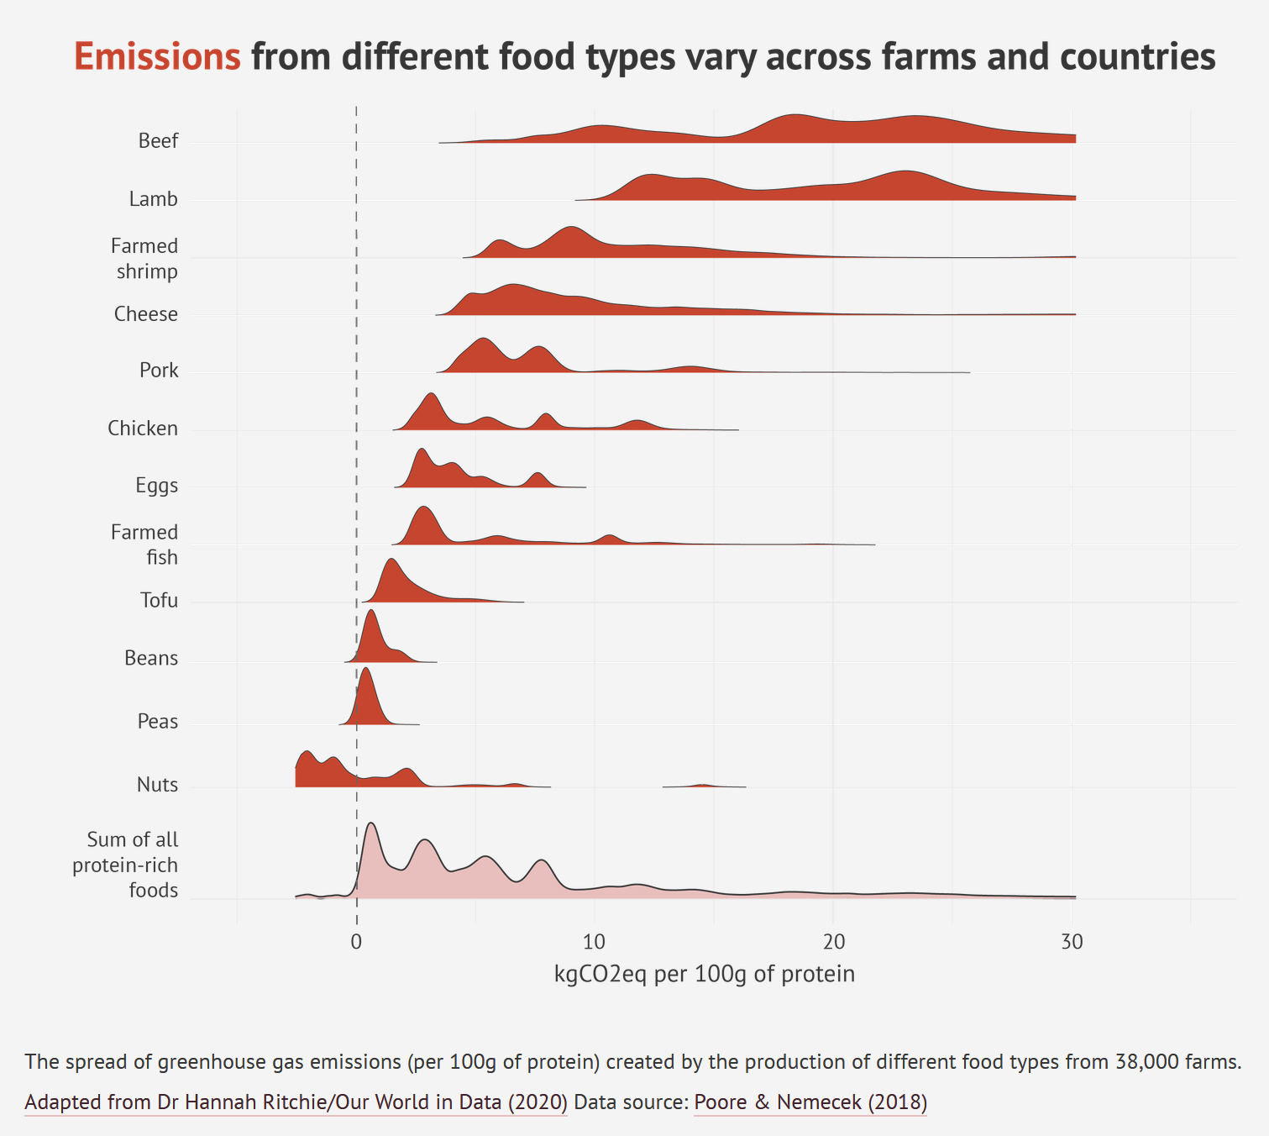
CO2 Emissions from various protein sources
Even if someone doesn’t give up meat, switching the type of meat, for example from beef to chicken, can have a large impact!
1 kg CO2eq = 2.3 miles driven in a car
image from interactive.carbonbrief.org
Notes:
Source of graph: https://interactive.carbonbrief.org/what-is-the-climate-impact-of-eating-meat-and-dairy/
Side note on grass-fed beef:
It is sometimes claimed that rearing cattle on grasslands can stimulate soil to uptake more carbon, helping to reduce climate change.
However, an analysis by the Food Climate Research Network in 2017 found that grass-fed cows release more greenhouse gas emissions through belching and manure than they are able to offset through boosting soil carbon levels.
[This slide was originally made by Columbia EcoReps]

Slide 40
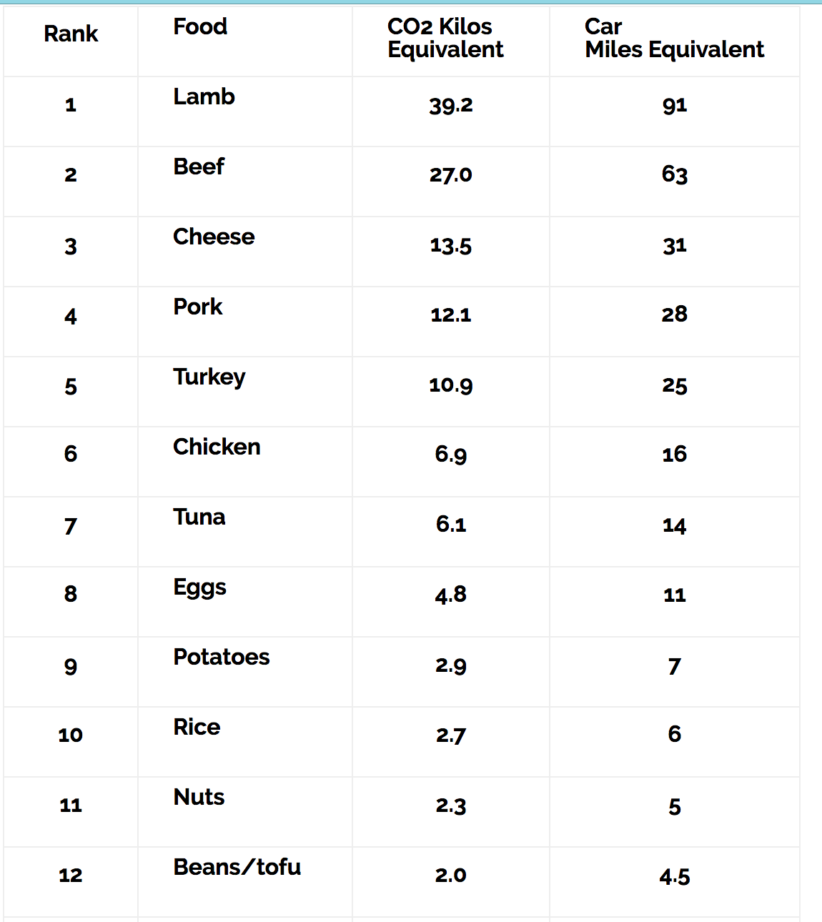
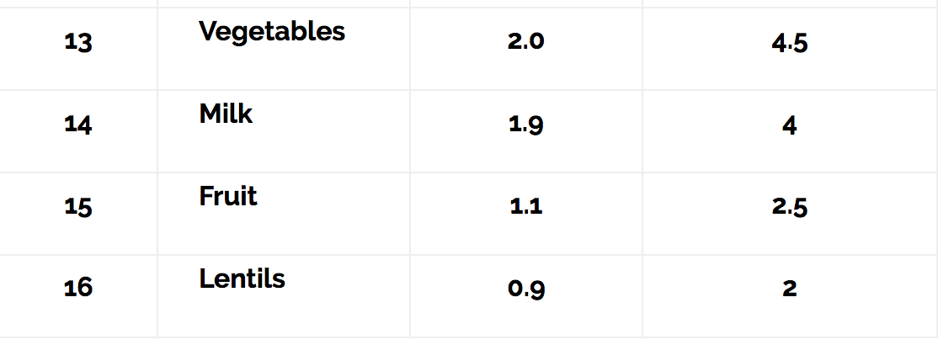
Putting these numbers in perspective
Notes:
https://www.nytimes.com/interactive/2017/06/09/climate/drawdown-climate-solutions-quiz.html
[This slide was originally made by Columbia EcoReps]

Slide 41
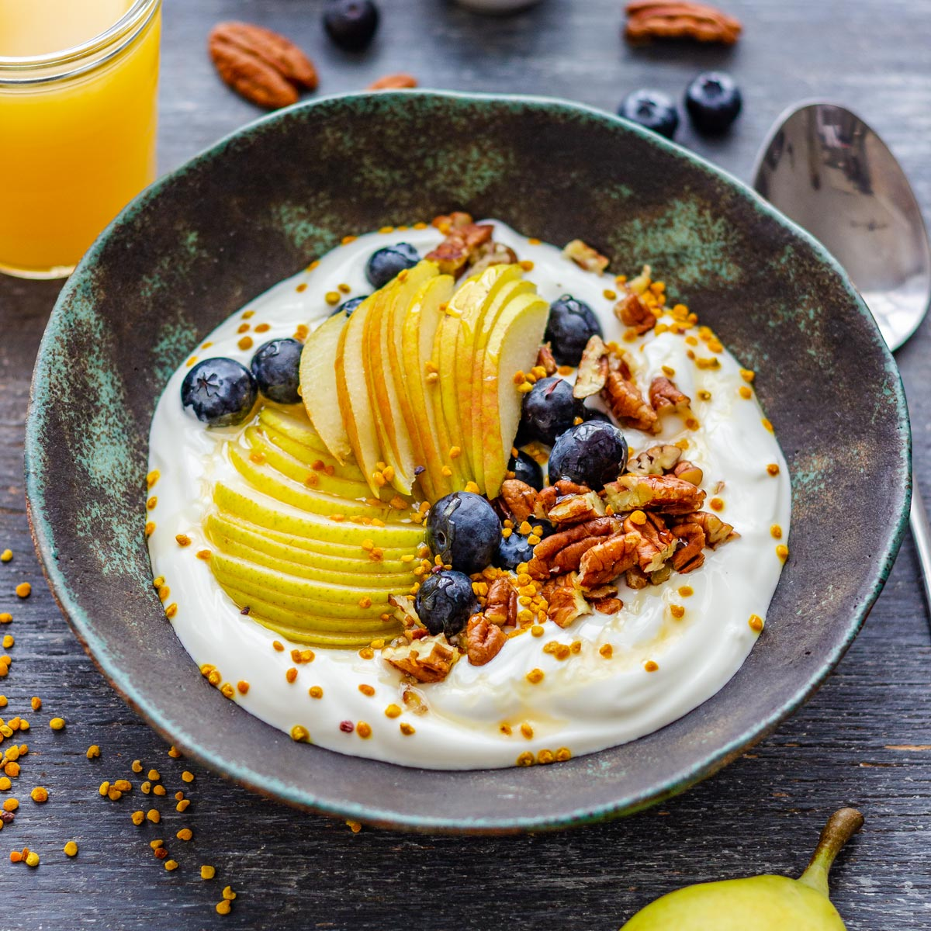
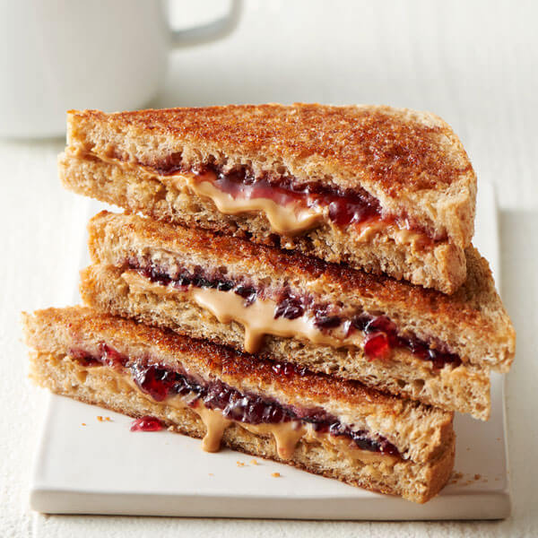
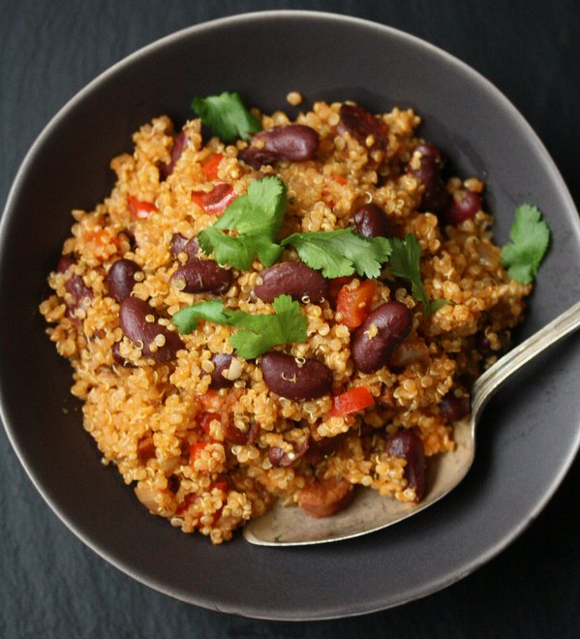
Health and Protein
Peanut butter, eggs, edamame, Greek yogurt, sunflower seeds, and black beans are cheap sources of non-meat protein!
How much protein does a person need?
Varies with health conditions, activity level, and weight.
If someone is sick, exercising a lot, or trying to gain muscle, they need more protein.
If sedentary: approx. 40-60 grams protein/day [source: Healthline]
For example:
Breakfast: Greek yogurt (20 g protein) (+fruit, vegetables, starch)
Lunch: Peanut butter and jelly sandwich (8 g for PB)
Dinner: Kidney beans and quinoa (13 +18 = 31 g) (+fruit, vegetables)
Total: 59 g protein
Could get even more protein with larger servings; soy milk; putting nuts in the yogurt; etc.
Non-meat sources of protein
Half-cup of tofu: 10 grams protein
1 cup soymilk: 7 grams protein
1 cup kidney beans: 13.4 grams protein
1 cup cooked quinoa: 18 grams protein
Black beans: 8 g per half cup
1 veggie pattie: 10 grams protein
1 serving of tempeh (100 grams): 18 grams protein
Pumpkin seeds: 10 grams protein per ¼ cup
Edamame: 9 grams per ½ cup
Peanut butter: 8 grams per 2 tablespoons
Cottage cheese: 12 g per half cup
Greek yogurt: 20 g per 7 oz
Lentils: 9 g per half cup
Notes:
How much protein do you need a day? https://www.healthline.com/nutrition/how-much-protein-per-day#muscles-and-strength
Maybe around 40-60 grams if sedentary; approx 1 g protein per pound if you’re trying to gain muscle
Hamburger: 21 g for a 3 oz lean ground beef burger https://healthyeating.sfgate.com/much-protein-hamburger-8392.html
Chicken: 24 g per 3 oz
Tilapia fish: 21 g per 3 oz
Some info from here: https://www.self.com/gallery/foods-with-more-protein-than-egg
[This slide was originally made by Columbia EcoReps; adapted by Sally Green]
Cheap sources of protein source: https://www.healthline.com/nutrition/cheap-protein-sources
Images:
Greek yogurt: https://www.google.com/url?sa=i&url=https%3A%2F%2Fwww.happyfoodstube.com%2Fgreek-yogurt-breakfast-bowl%2F&psig=AOvVaw2mBeZGH7oIqM7MjFohnhtY&ust=1636957655582000&source=images&cd=vfe&ved=0CAwQjhxqFwoTCODPy9acl_QCFQAAAAAdAAAAABAK
Peanut butter and jelly sandwich: https://www.google.com/url?sa=i&url=https%3A%2F%2Fwww.landolakes.com%2Frecipe%2F21330%2Fgrilled-peanut-butter-jelly-sandwich%2F&psig=AOvVaw3pz6V14LVg6sjmvKGczhTM&ust=1636957732318000&source=images&cd=vfe&ved=0CAwQjhxqFwoTCKjqjfOcl_QCFQAAAAAdAAAAABAF
Kidney beans and quinoa: https://www.google.com/url?sa=i&url=https%3A%2F%2Fwww.dvo.com%2Fnewsletter%2Fweekly%2F2015%2F5-29-1986%2Fside5b.html&psig=AOvVaw02bkhZOYmwnZ4k_AeygrVv&ust=1636957786356000&source=images&cd=vfe&ved=0CAwQjhxqFwoTCMC2kpKdl_QCFQAAAAAdAAAAABAD

Slide 42
Reducing the demand for meat (especially beef) and dairy and increasing consumption of other protein sources can decrease carbon emissions

Slide 43
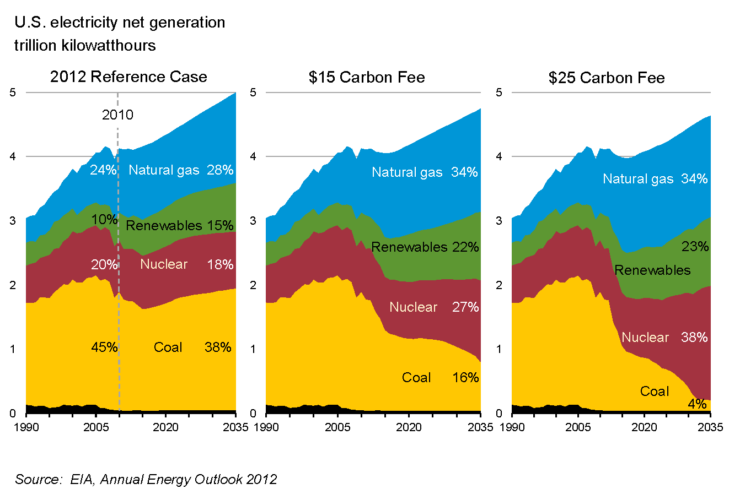
Why aren’t we doing more?
Psychological reasons
Climate Change doesn’t seem like a huge threat because it’s invisible, unprecedented, a drawn-out process, complicated, and caused by us (source: Dan Miller TEDx)
And some people still don’t think climate change is real or caused by humans…
Politics, economics
Although the explanation behind Climate Change and many of the technological solutions to it come from science, implementing these solutions or other ones often involves politics and economics
E.g. Carbon tax, government incentives, investments in research and development of technology
A carbon tax is an economic solution that could have a large impact (but is more difficult to implement)

Slide 44
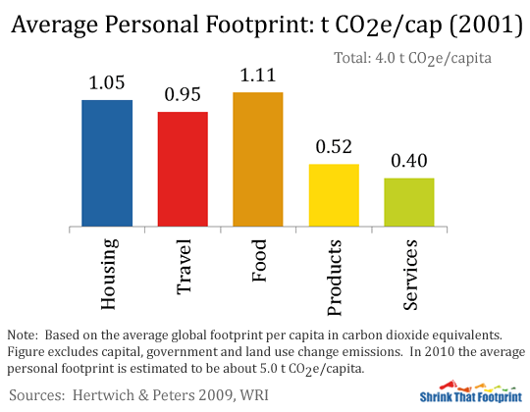
These are broader societal goals; what can I do personally?
Eat less meat and dairy; switch from beef to chicken
Minimize your use of resources -- everything is FINITE!
Make your home energy efficient with insulation, EnergyStar appliances, heat pumps if applicable; change your energy source! (you can do this on ConEd’s website)
Contact your government leaders at the local, state, and federal levels
Join environmental and environmental justice organizations
Talk about this with your friends and family
Study this in school
Work on developing and improving these solutions (science, engineering)
Work on implementing these solutions (government, nonprofits, activist groups, legal issues)
Work on educating others (teachers, camps, professors)
Work on understanding and communicating the issues (writing, history, sociology, psychology, art)
We can do it! Every bit counts

Slide 45
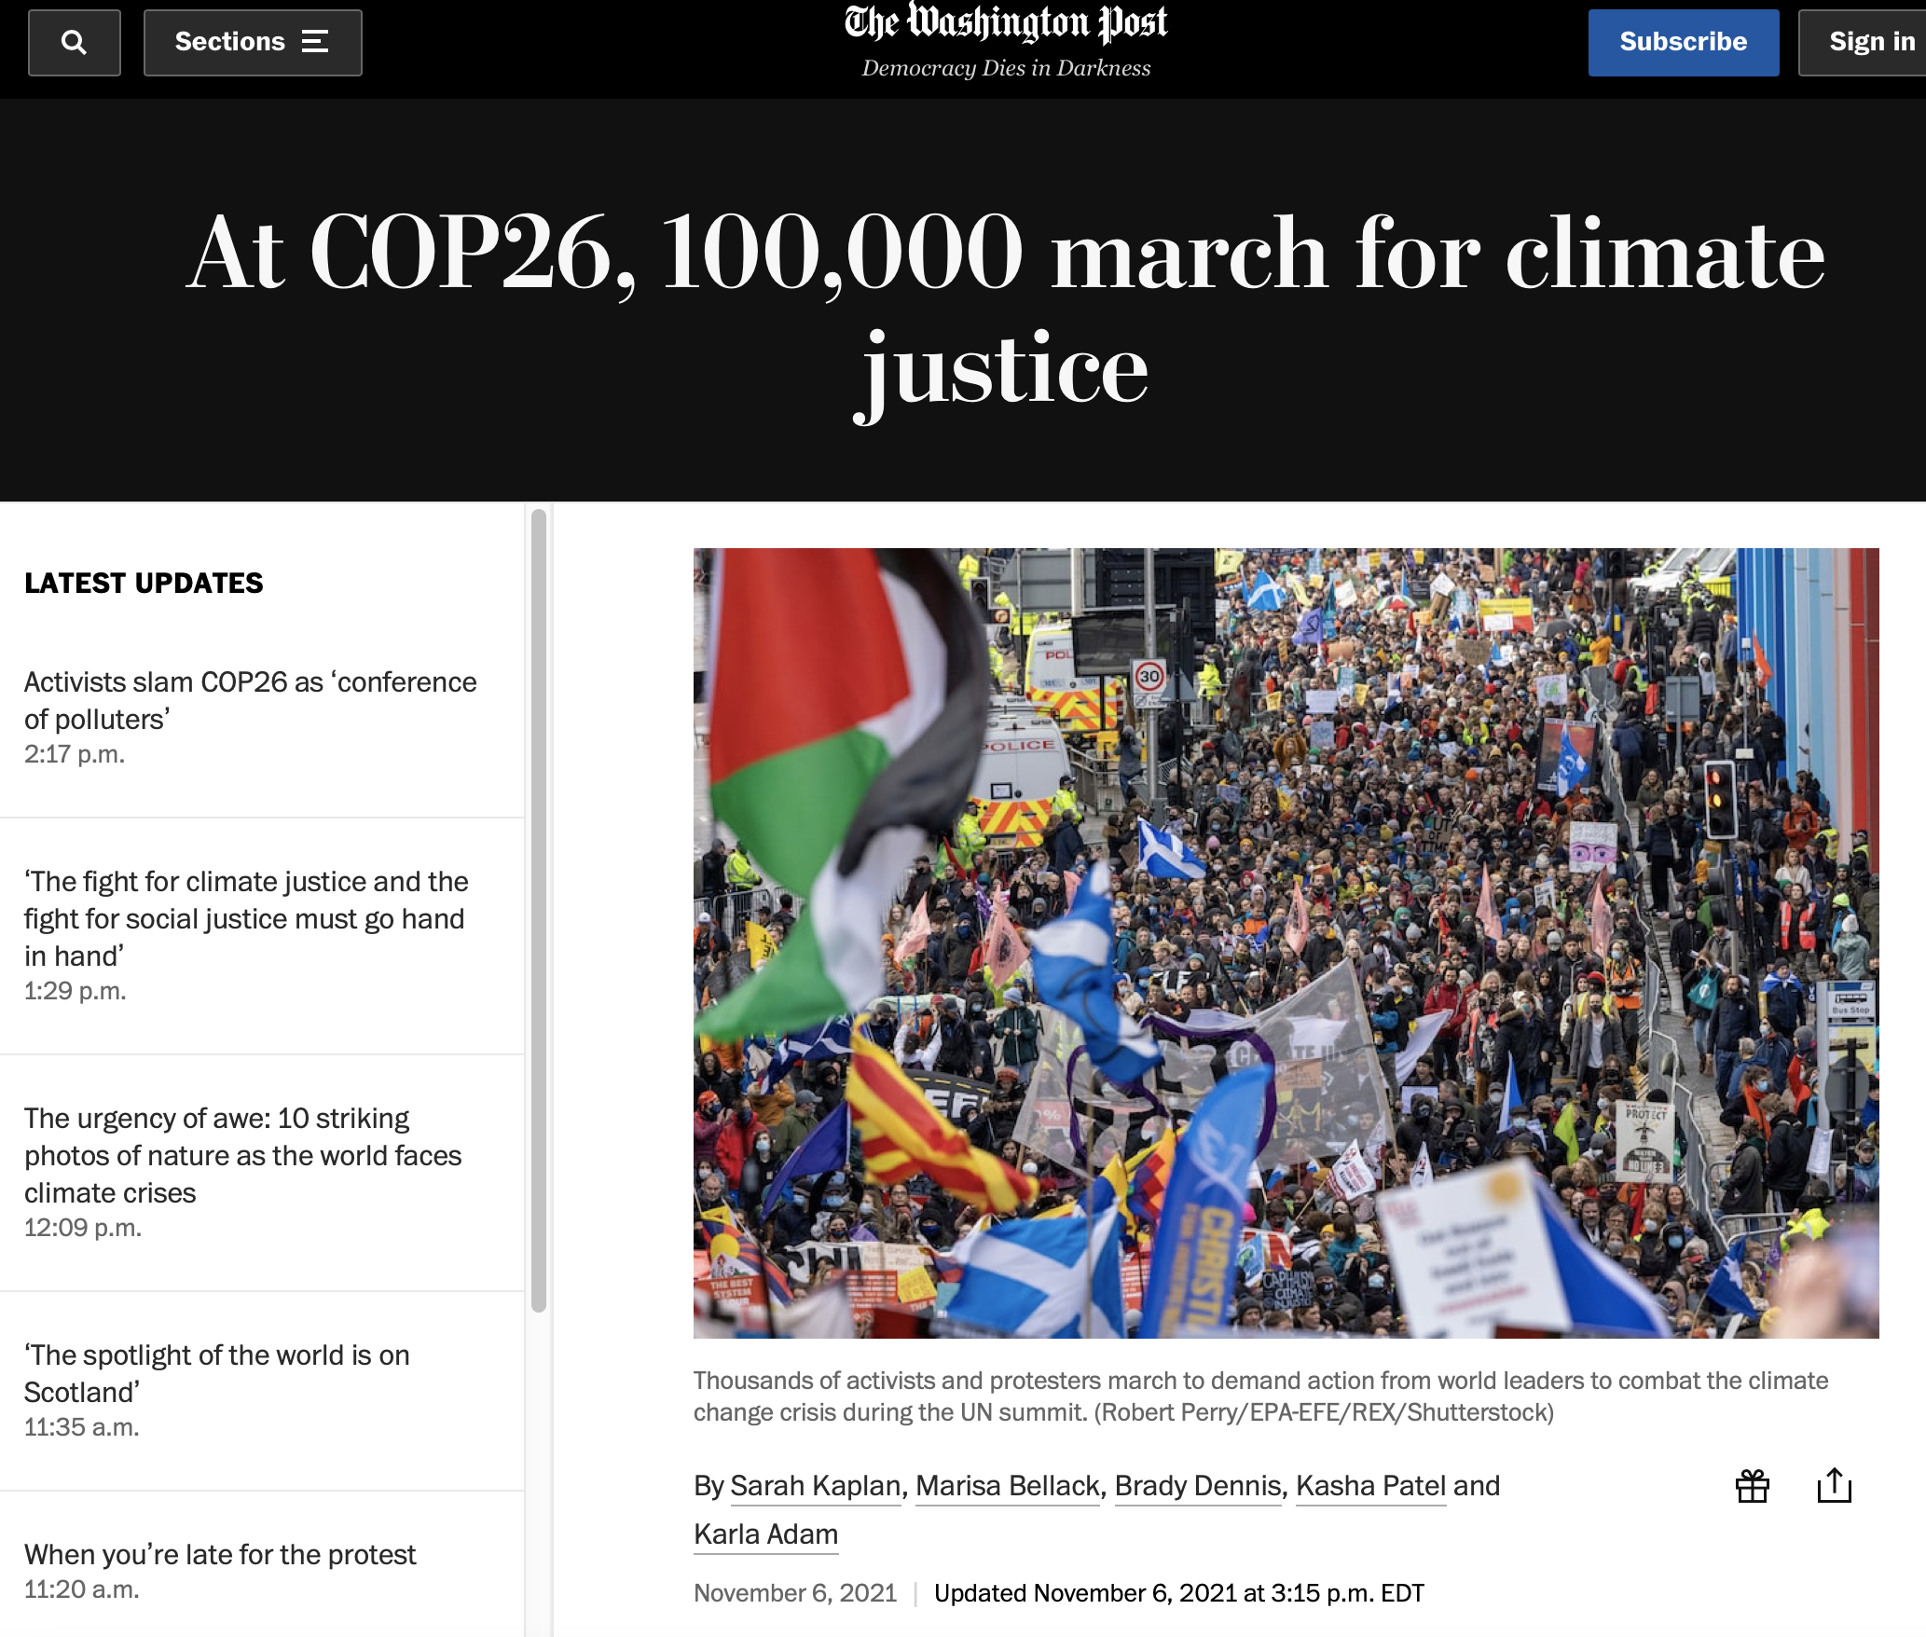
Look at how many people are in this picture. Look at how many people are in this zoom room. There are a LOT of us that care about climate justice and are fighting for it in our own ways.
Notes:
https://www.washingtonpost.com/climate-environment/2021/11/06/cop26-climate-protests-live-updates/

Slide 46
Adopt this perspective: “We are making great progress, AND we need to do more.”
Acknowledge the good (the progress and hope) while also acknowledging the need to do more.

Slide 47
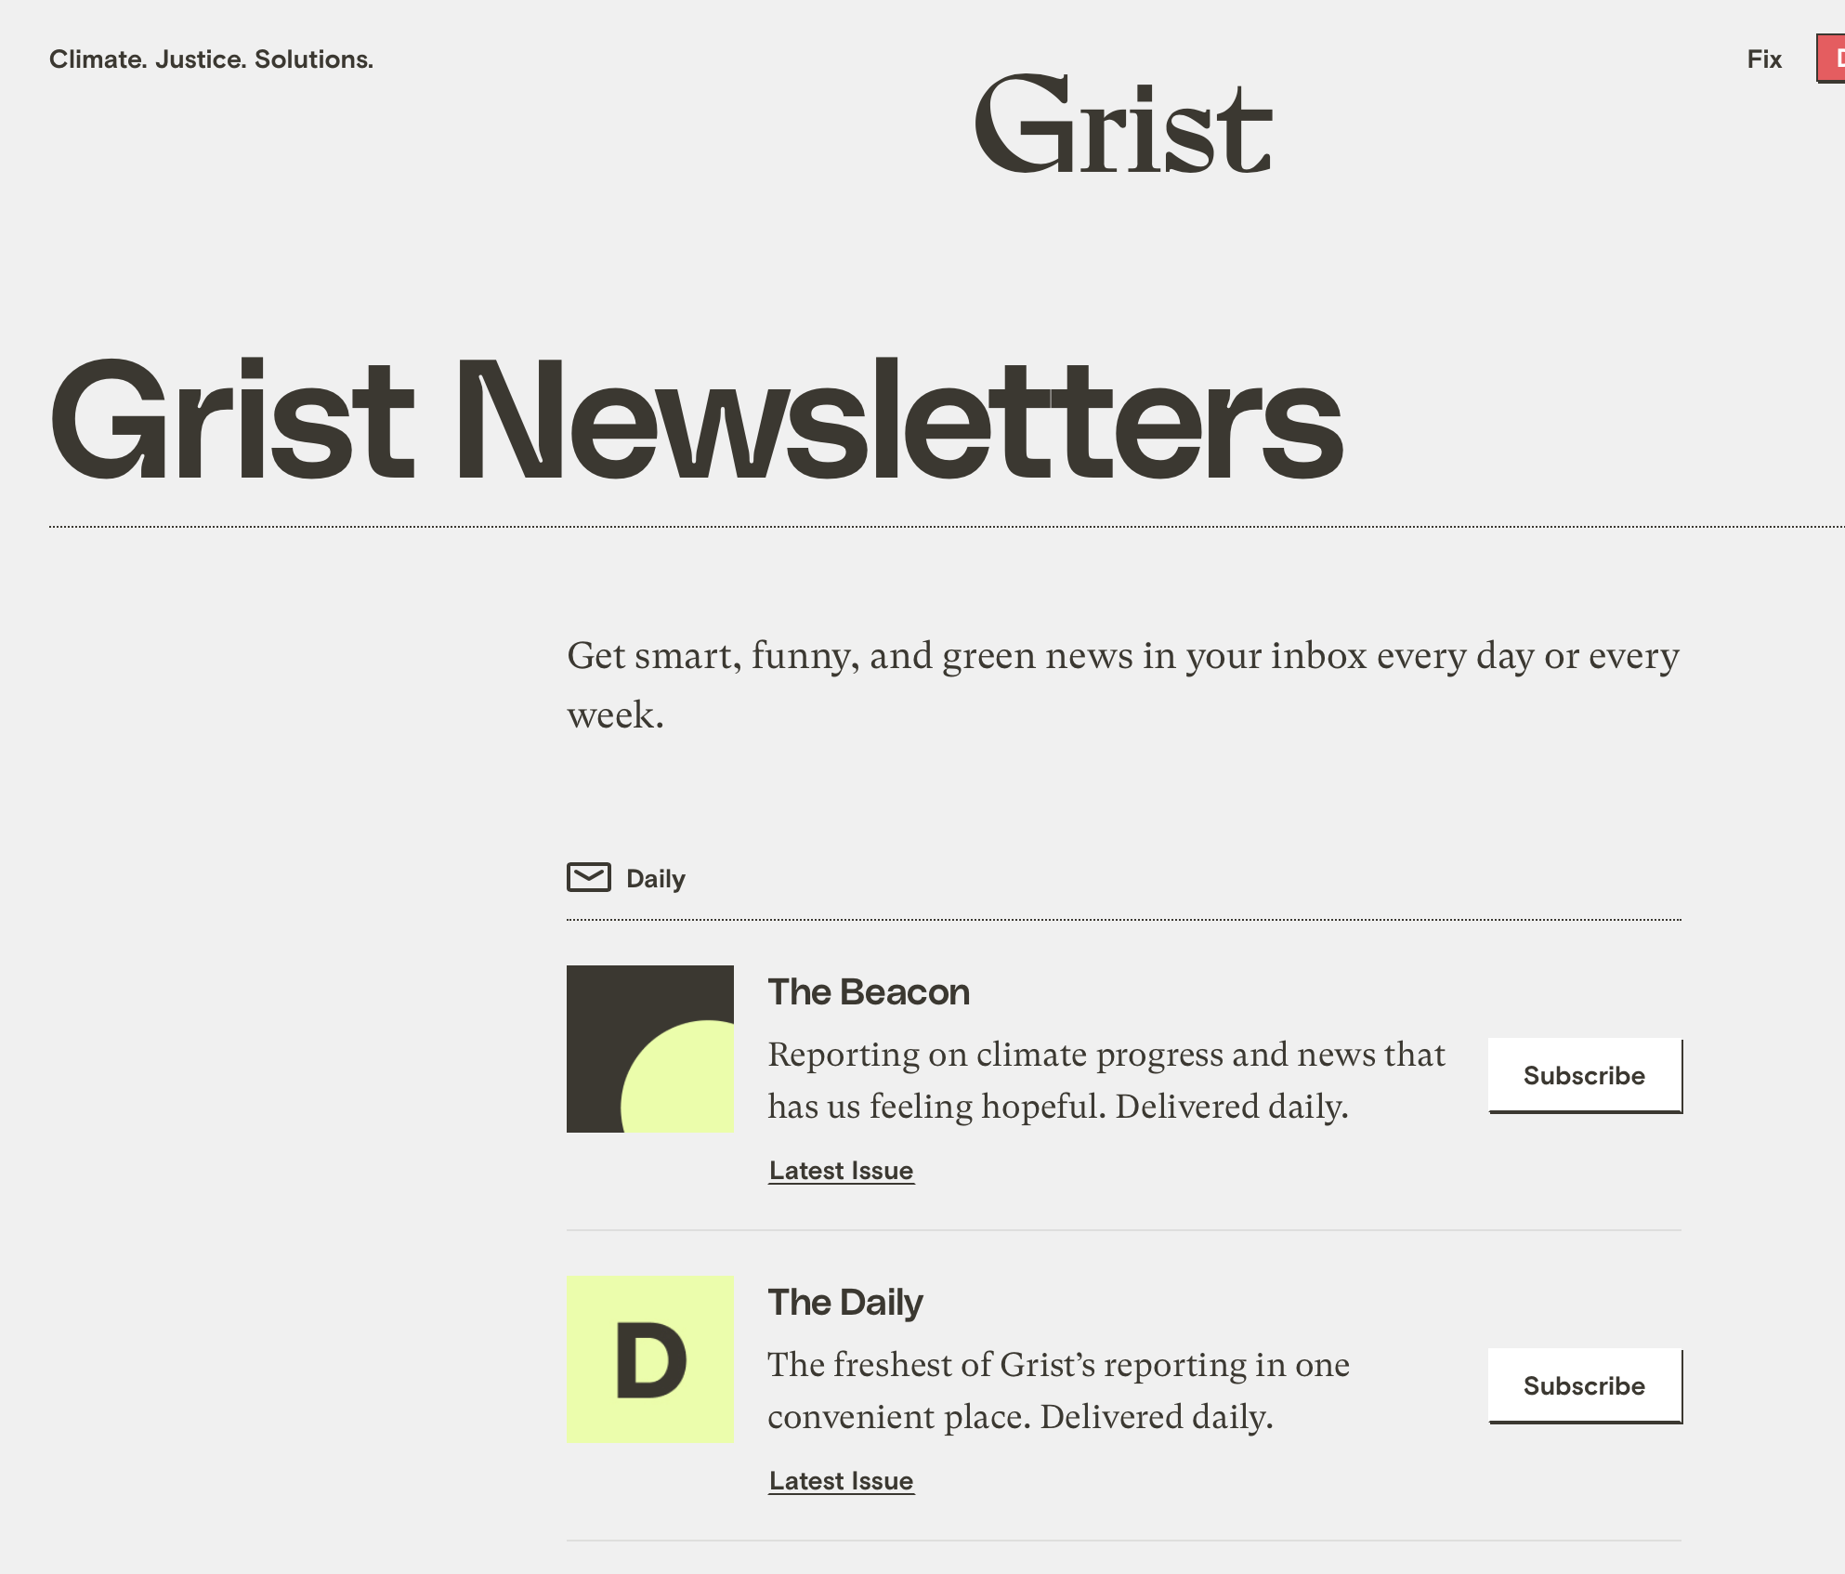
Where to find more climate hope: Grist’s “Beacon” newsletter – go to grist.org

Slide 48
Take a minute to reflect.
What are your key takeaways from this class? What thoughts do you have?
Take a minute on your own to reflect. You can write things down if you want. Then we’ll share as a group and you can put thoughts in the chat.
What questions do you have?

Slide 49
Contact me!
Sally Green
For any questions on the environment, Climate Change, to discuss anything talked about in class, for talking about college life, transition to college, college application process, engineering, etc.
Caveat: I may take a few days to respond!
Thank you for coming!

